Slide 1
New Intake evening 2025
Welcome to GTS
Ready Respectful Safe
Notes:
Please save questions for the end

Slide 2
Before we start
This PowerPoint will be put onto the GTS website after this evening.
If you don’t remember everything this evening don’t worry!

Slide 3
Our School Values
Our School Values are Ready, Respectful, Safe. This underpins every aspect of the GTS way.
We use these words in language when engaging with our pupils
We use these words when we consider how we want our pupils to be during the transition process, towards themselves and others
We use these words when we consider how we want our young people to be when they leave GTS.
Ready to take on the world, Respectful of others and able to conduct themselves in a Safe way.

Slide 4
Pontio = To Bridge
Transition = a change from one form to another, or the process by which this happens
Notes:
I believe that Transition to imply change can be a worrying thing. I prefer the word Pontio ( To Bridge) as the pupils can take all of the good that they have developed from their time in Primary into Secondary school.

Slide 5
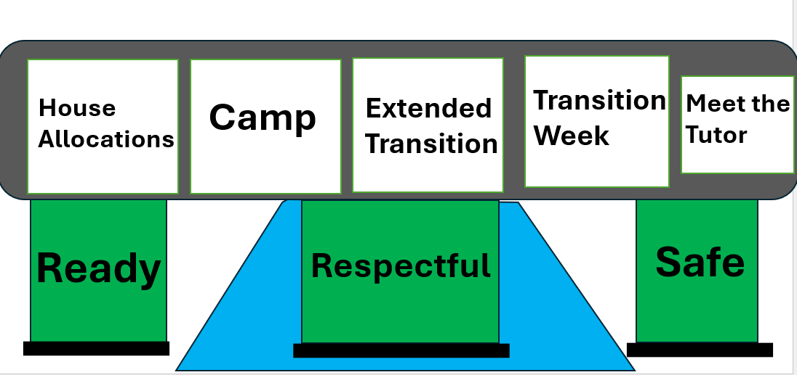
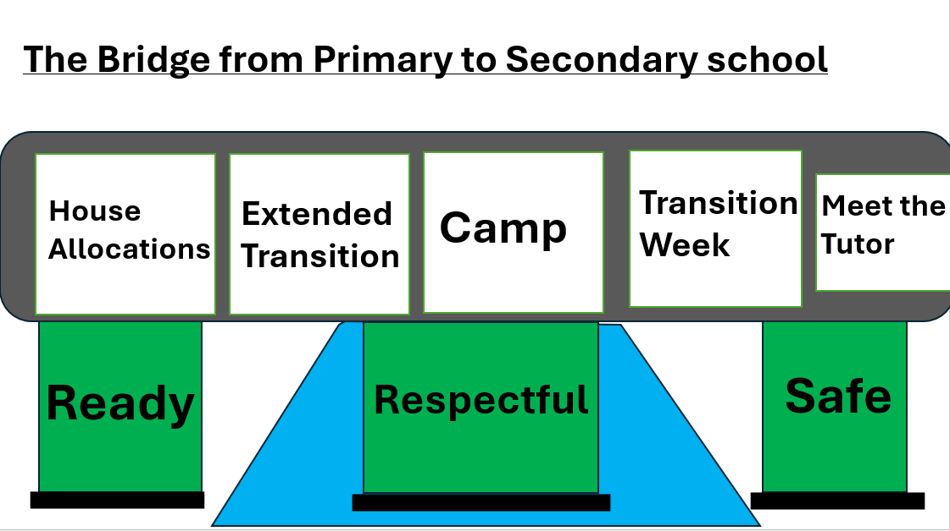
The Bridge from Primary to Secondary school
Year 6
Year 7

Slide 6
The Bridge from Primary to Secondary school
Transition Week
Meet the Tutor
House Allocations
Extended Transition
Camp
Ready
Respectful
Safe

Slide 7
House Allocations
In GTS we have 4 Houses that all pupils are allocated into:
Endurance / Resolution / Discovery / Endeavour
The House system serves many purposes in GTS:
Pastoral Support, Pupil Coaches, Heads of House and House Tutors
House Time
Sense of School Pride and Identity
Sports Day
Charity Days

Slide 8
House Allocations - How do they work?
Endurance / Resolution / Discovery / Endeavour
Siblings enter the same house
If you come from a smaller school, you most likely will stay in the same house for example:
4 Pupils from the same Primary would all go into Discovery
+8 Pupils from the same Primary would be split.
4 into Endeavour and 4 into Resolution
Your child's house allocation does not affect their GTS experience, it is the same high-quality experience in every house.

Slide 9
House Allocations - How do they work?
Endurance / Resolution / Discovery / Endeavour
You will receive a letter for your house allocation
If you are not in the same house as your friends do not worry.
Learning groups are different to tutor groups so you may still be with friends that are not in your tutor group

Slide 10
The Bridge from Primary to Secondary school
Transition Week
Meet the Tutor
House Allocations
Extended Transition
Camp
Ready
Respectful
Safe

Slide 11
How confident do I feel about Transition?
Everyone’s experience will be different and that’s okay! Some people will find Transition easy, and others may find some aspects challenging. That’s normal. However, by trying your best at every opportunity you are given, you will overcome challenges and become more resilient.

Slide 12
For some people Transition may feel like walking over a strong bridge. It will be effortless and easy.

Slide 13
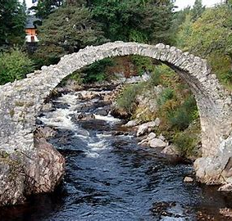
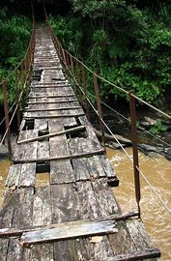
For others it may feel like walking over an uneven bridge. Nervous or challenging.

Slide 14
How can we help? – Extended Transition
For our pupils who need a little bit of extra help transitioning before our full transition week takes place.
extra sessions running up to transition week:
Wednesday 4th June 9.15am – 10.45am
(Familiarity with SEND staff of Great Torrington school)
Wednesday 11th June 9.15am – 10.45am
(Familiarity with the building and site)
Wednesday 18th June 9.15am – 10.45am
(Familiarity with new peers and friends they will be spending time with)

Slide 15
Hardy Centre
Extended Transition will be run by the Hardy Centre.
The Hardy Centre helps pupils that have a variety of needs and/or on a EHCP to ensure they can access the wider curriculum that we offer at GTS.
The Hardy Centre will be available for pupils to access if they need to re-regulate during transition week

Slide 16
The Bridge from Primary to Secondary school
Transition Week
Meet the Tutor
House Allocations
Extended Transition
Camp
Ready
Respectful
Safe

Slide 17
Transition Week Dates
Monday 23rd June & Tuesday 24th June
Resolution and Endeavour (Group A) go to the Ultimate Adventure Centre (stay one night).
Discovery and Endurance (Group B) school-based transition.
Wednesday 25th June & Thursday 26th June
Discovery and Endurance (Group B) go to the Ultimate Adventure Centre (stay one night).
Resolution and Endeavour (Group A) school-based transition.
Notes:
Any pupils with siblings in the school already can use the house as a timeline for what they will be doing and when.

Slide 18
Camp - The Ultimate Adventure Centre Ltd.
Monday 23rd June & Tuesday 24th June
Resolution and Endeavour (Group A) go to the Ultimate Adventure Centre (stay one night).
Wednesday 25th June & Thursday 26th June
Discovery and Endurance (Group B) go to the Ultimate Adventure Centre (stay one night).

Slide 19
Payment for Camp
Price of Camp - £105
You can pay for camp in 1 of 2 ways.
1.Split the payment £55 Deposit + £50 to make up the final balance.
2.Pay in full by the 30th of April
Deposit of £ 55 required by 30th April, and the final balance paid by 4th of June.
Payment is to be made over the phone. The Finance office is closed over the Holidays.
If you have an existing child in the school, you may pay through IRIS ParentMail through that child’s account.
Access for All
Not all of year 6 choose to go to camp. Those who choose not attend camp can come to GTS for four days of school-based transition.

Slide 20
Camp - The Ultimate Adventure Centre Ltd.
A host of outdoor activities and games
A chance to bond with new peers that are in your house
Need to bring packed lunch for the first day
Staying overnight in tents, chance to enjoy the summer weather
No mobile phones, you will not need them (unless a medical requirement such as Diabities)

Slide 21
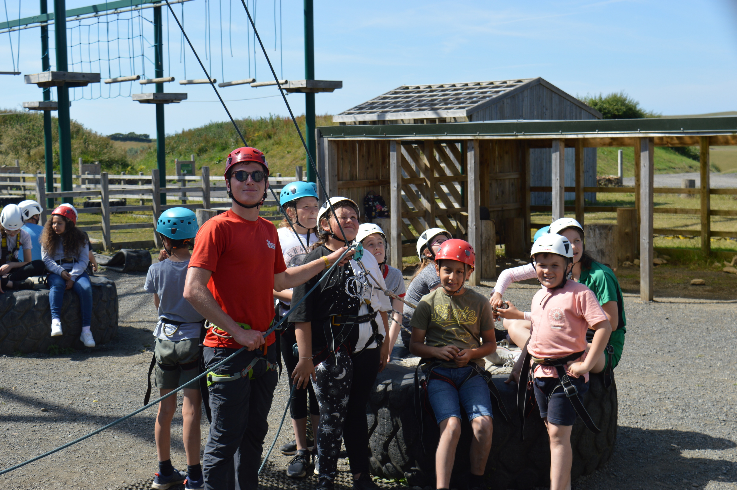
Photos from Camp 2022

Slide 22
The Bridge from Primary to Secondary school
Transition Week
Meet the Tutor
House Allocations
Extended Transition
Camp
Ready
Respectful
Safe

Slide 23
Transition Week Dates for time in School
Monday 23rd June & Tuesday 24th June
Discovery and Endurance (Group B) school-based transition.
Wednesday 25th June & Thursday 26th June
Resolution and Endeavour (Group A) school-based transition.
Notes:
Any pupils with siblings in the school already can use the house as a timeline for what they will be doing and when.

Slide 24
Transition Week in School
By the end of the week your child will:
Get to know the school building
In touch with procedures for example where to go in the event of a fire drill
Get to know your new peers
Meet some of your new teachers
Have classes in a secondary school format

Slide 25
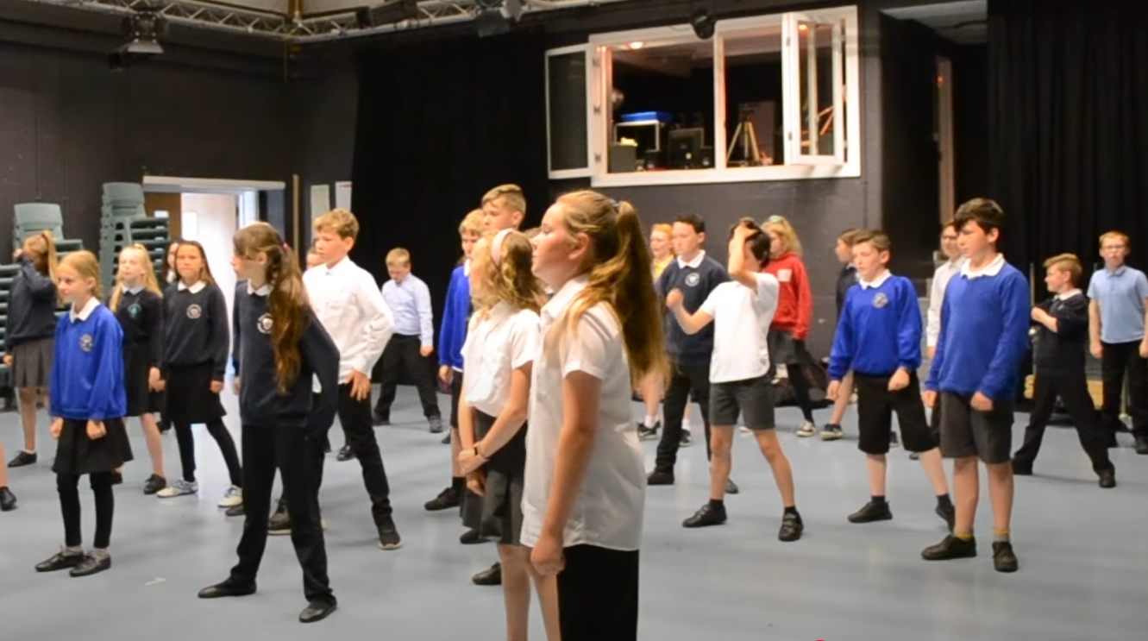
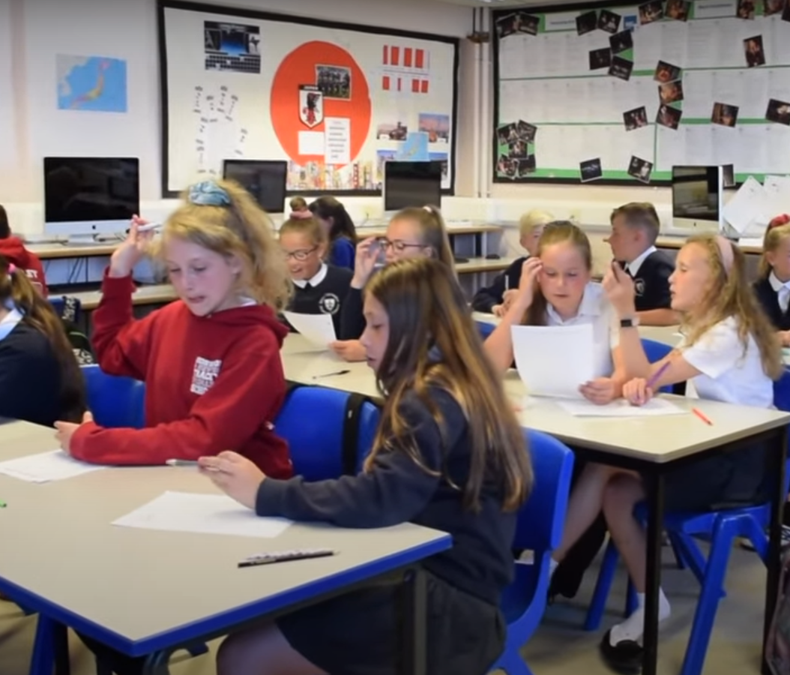
School Based Transition

Slide 26
What do our current year 7 pupils think of Transition?
When asked: What did you enjoy about Transition last year?
Charlie- “meeting the teachers and getting to see how the school operates.”
Carys- “Meeting the year 7 transition leaders and meeting new people in the new house. It helped me to know where I was going.”

Slide 27
The Bridge from Primary to Secondary school
Transition Week
Meet the Tutor
House Allocations
Extended Transition
Camp
Ready
Respectful
Safe

Slide 28
Meet the Tutor Evening – 14th July
This is an evening that is organised so you and your child can meet our high-quality year 7 tutors. The evening is about understanding:
Expectations for September.
What your time in GTS will look like come September
A time to get to know your new tutor and have a quick chat with your new peers

Slide 29
The Bridge from Primary to Secondary school
Extended Transition
Transition Week
Meet the Tutor
House Allocations
Camp
Ready
Respectful
Safe

Slide 30
Quick Reminder
This PowerPoint will be put onto the GTS website after this evening.
If you don’t remember everything this evening don’t worry!

Slide 31
Moving on from this evening
If you think we should know something. Tell us. If you feel like your child's Primary school should make us aware of something. Tell them.
Positive encouragement throughout this time. Transition is a large process.
If you have any questions, feel free to ask. Anything I can’t answer now I’ll write it down and get back to you.
Please feel free to discuss with our Junior Leaders at the back about their time at GTS.

Slide 32
Thank you very much for your time

