Slide 1
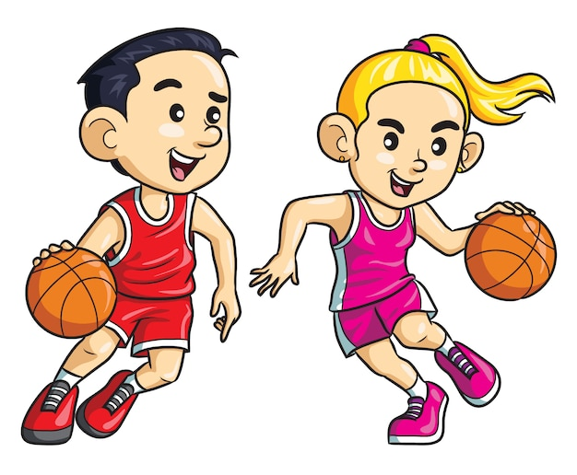
Want to get some BASKETBAL coaching?
Have some fun & learn new skills?
Coached by Ex - England Player & U18 National Coach
When? Tuesday 4th April:
Primary Yrs 4–6: 9:30 am – 12:00 pm
Secondary Yrs 7–11: 1:00 pm – 3:30 pm
Where? GTS Sports Hall
Cost? £5.00 per person
To register your place: email your child’s name, age & an emergency contact number by Thursday 30th March to:
Adaniel@gts.devon.sch.uk

