Slide 1
Photopea
The more powerful alternative to Paint.net

Slide 2
Topic Goal
Introduce Photopea
01
Explore the tools on Photopea
02
Develop a range of images using the software.
03

Slide 3
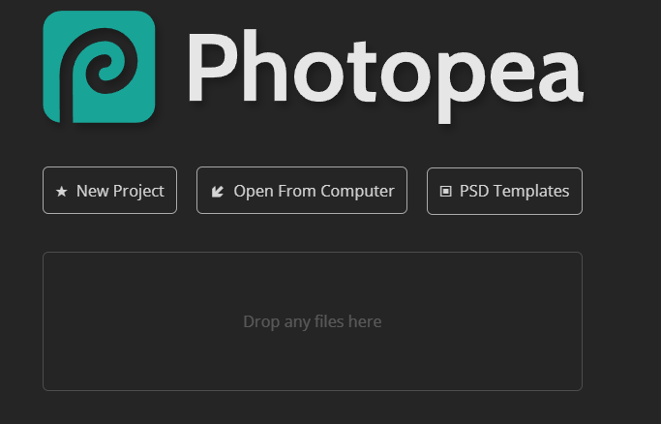
Introducing Photopea
Photopea | Online Photo Editor
Search for Photopea.com
Photopea.com is a online photo editor that is best described as a mix between paint.net and photoshop.
As its an online editor you will be able to access it on any device as long as you have an internet connection.

Slide 4
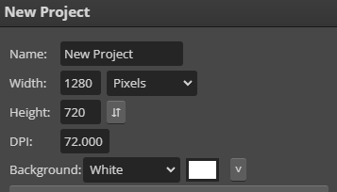
Setting up a page
Click on the “new project button”
You are then able to create a new canvas just like you do when you use paint.net
As you can see in the screen shot you can set the size of your canvas as well as set the background colour.
Once your happy with the settings you can then click create.

Slide 5
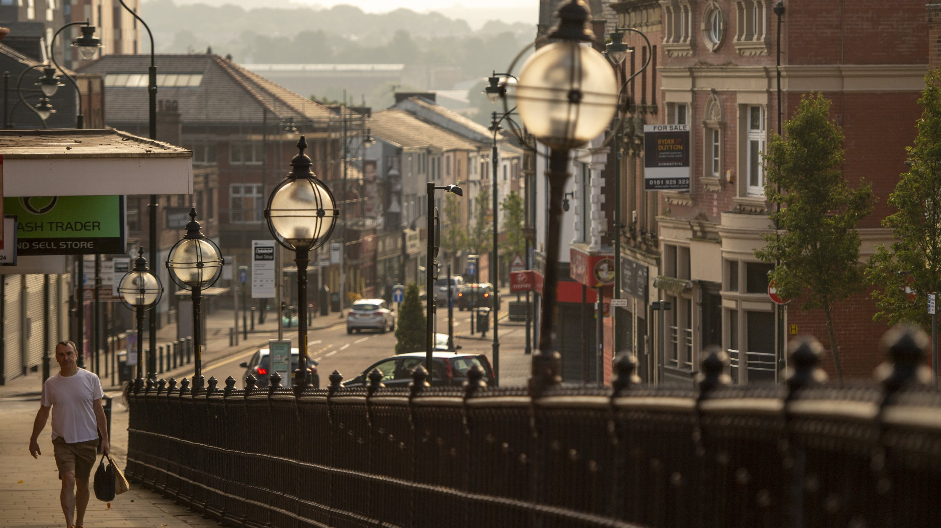
The Oldham Challenge
Learning how to use Photopea by experimenting

Slide 6
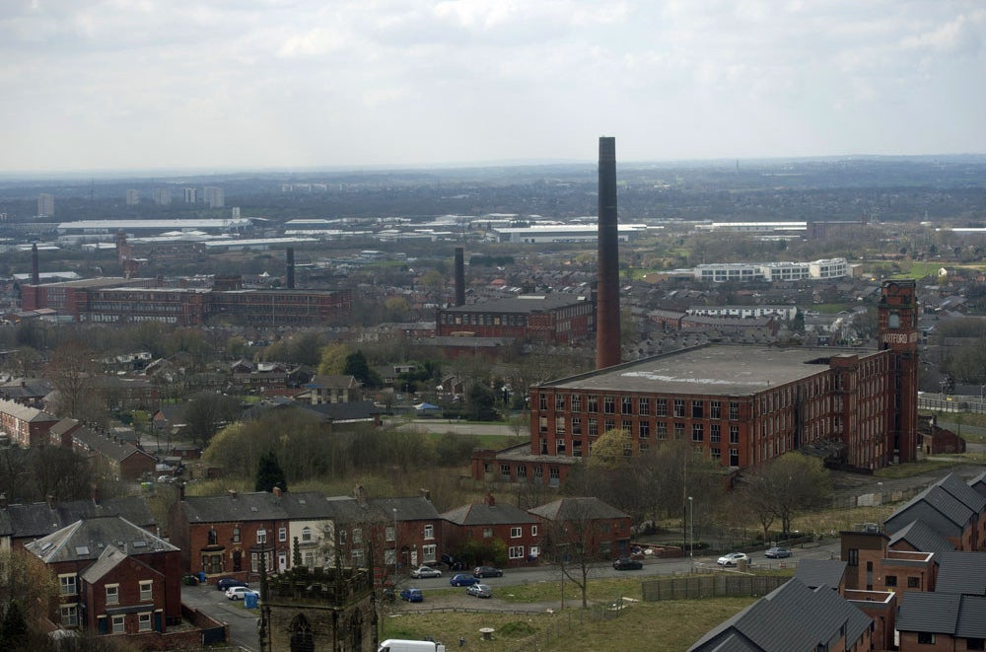
Brief – 1976 Oldham Tourism Goals
Watch the clip: Visit Oldham - BBC Archive ( https://www.bbc.co.uk/archive/visit-oldham/z7r8bdm )
Oldham 1976 has an issue.
It wishes to become a tourist centre of the North.
As you can tell … it will need some help.

Slide 7
Challenge
Design and create the following products to advertise Oldham as a tourist destination:
Postcard
Keyring
Car Sticker
To do this you will need to research the sizes for these products and set the canvas size appropriately for each piece.

