Slide 1
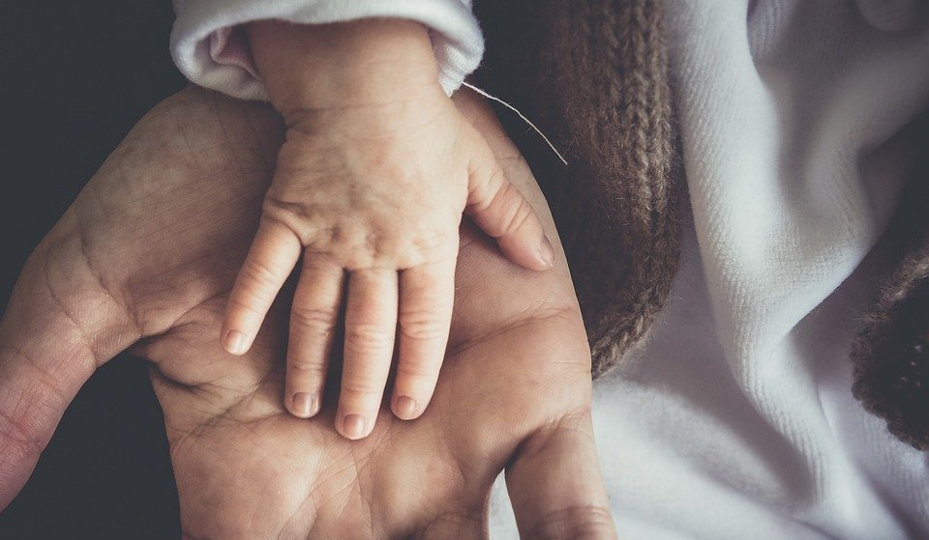
Starter – Load up 10fast fingers!
Log into the computers.
Open chrome
Search for kahoot.
Open a new tab and Practice 10fastfingers

Slide 2
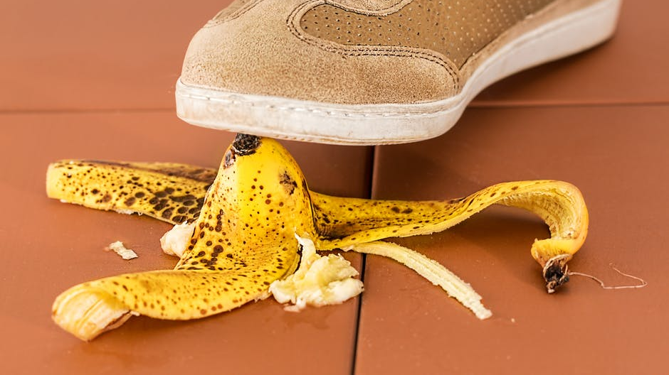
Digital Footprint
What we leave online, stays online.

Slide 3
Session goals – Digital Foot Prints
Investigate
Investigate if “What we put online stays online” is true.
Review
Review how we appear online.
Discuss
What are cookies.
Discuss
Discuss the long-term effects of our digital footprint.

Slide 4
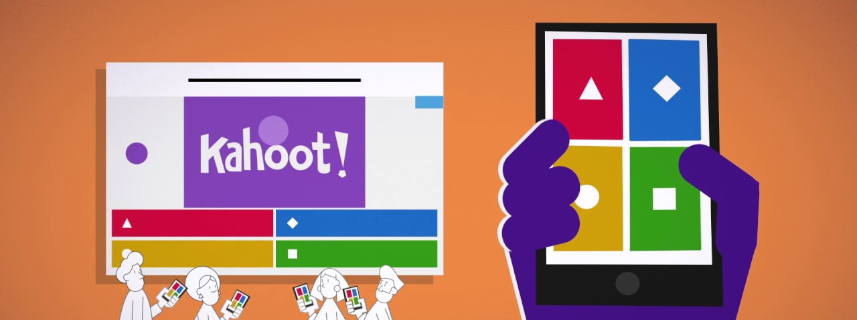
Kahoot!
Log onto Kahoot.
Notes:
https://create.kahoot.it/details/14b15a7d-d9f5-485c-8d94-434968d7395c

Slide 5
New Document – Digital footprint
Open Microsoft PowerPoint.
Produce a new document.
Save the document as Digital Footprint in to your Year 7 Computing folder.
Add the title: Digital Footprint.

Slide 6
Task: Add a new slide.
Add a new title & content slide with the title: Initial Idea of what is meant by digital footprint

Slide 7
What do you think is meant by digital footprint?
When instructed turn to the people next to you and discuss
“What does the term digital footprint mean?”

Slide 8
Task: Write your initial ideas into your PowerPoint.
Then write your initial definition of what a digital footprint is.

Slide 9
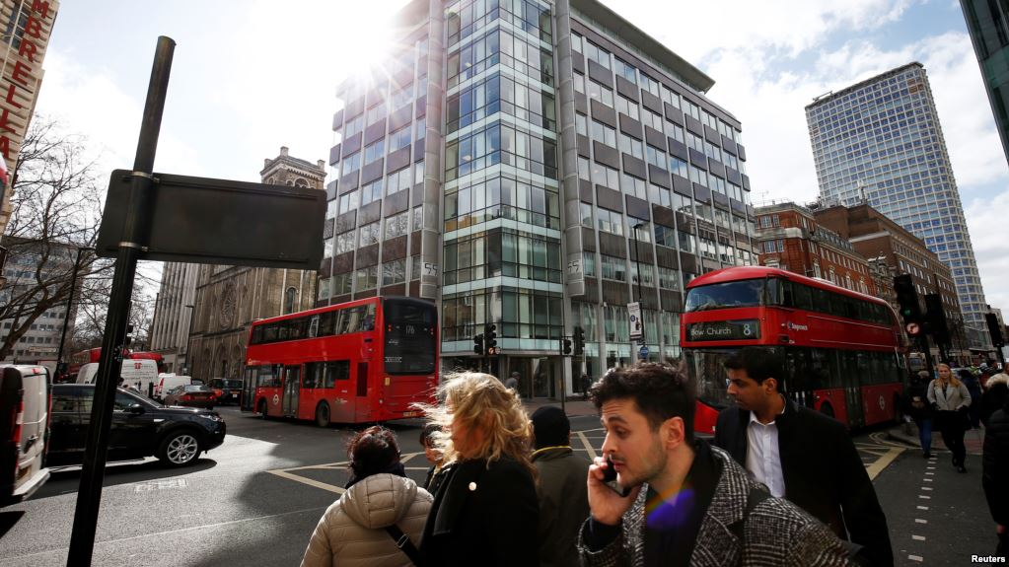
The majority of cybercrimes are related to Digital Footprints.
What does a cyber criminal look like?
Notes:
The second picture is of Cambridge Analytica which was caught up in stealing and abusing £300 million worth of peoples digital foot prints / data. This is to show students that its massive companies that use this information rather than “hackers”.

Slide 10
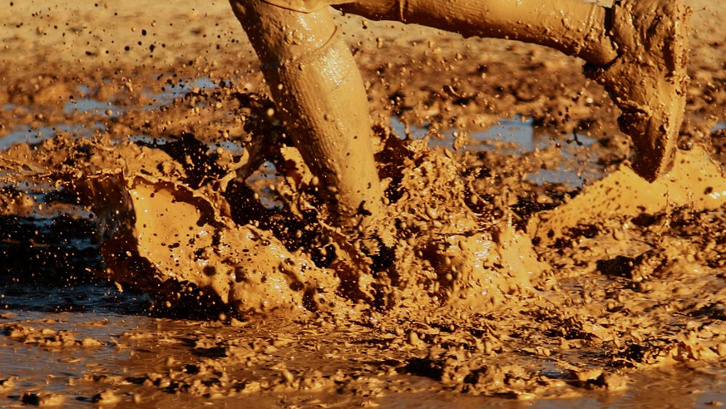
What do you see?
Think of the internet as a giant very muddy puddle.

Slide 11
When you interact with the puddle you leave footprints.
Can you delete your footprint?

Slide 12
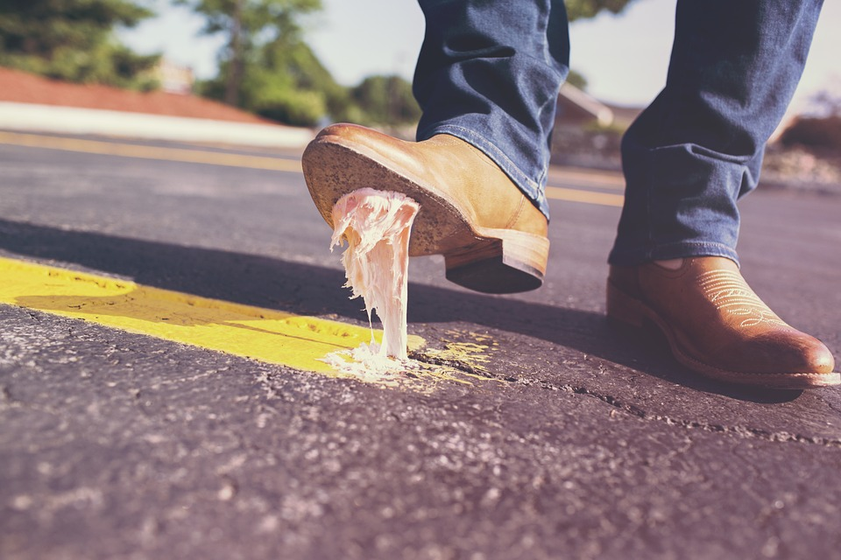
Lets define / describe digital footprints.
Add a new slide with the title – A definition of a digital footprint.
Using some of the words below write a definition of what digital footprint means.
Words: Online Internet Information Data Left Stored Undeletable Personal “What you put online” Location Ownership Copied

Slide 13
Lets experiment!
First get into pairs.
Ask each other the following pieces of information:
Full name.
Which town / village they live in (NOT ADDRESS!) .
Which schools have they been in.

Slide 14
Lets experiment!
Using these pieces of information conduct a search for them. See how little or how much information online you can find out about them.
Tip : Try using google images or add social media company names into the search.
Share your findings with your partner.

Slide 15
Task: Create a new slide
Add the title: My Digital Footprint Experiment - Results
Then in the content box answer the following:
Did your partner find any information about you online?
Was it hard to find information?

Slide 16
Writing up the conclusion.
Create a new slide with the title: My Thoughts on the Experiment.
On the slide write the following:
How did it make you feel?
Do you have control of this information?
Could this information have a long lasting effect on you/your life?

Slide 17
All about Cookies
What are cookies and why are they important?

Slide 18
Have you seen this before?

Slide 19
So, What are cookies?
Let's watch this clip together investigating cookies.
While you watch it try and answer the following questions:
Are cookies important?
How are they used?
Can they be misused?
Notes:
https://www.youtube.com/watch?v=rdVPflECed8&ab_channel=CreateaProWebsite

Slide 20
What are cookies?
Add a new slide with the title: What are cookies?
Then describe: what cookies are, how they are used and why they are a tool that can be misused.
You can use the internet to help you.

Slide 21
Social footprints.
Have you seen these sites before?

Slide 22
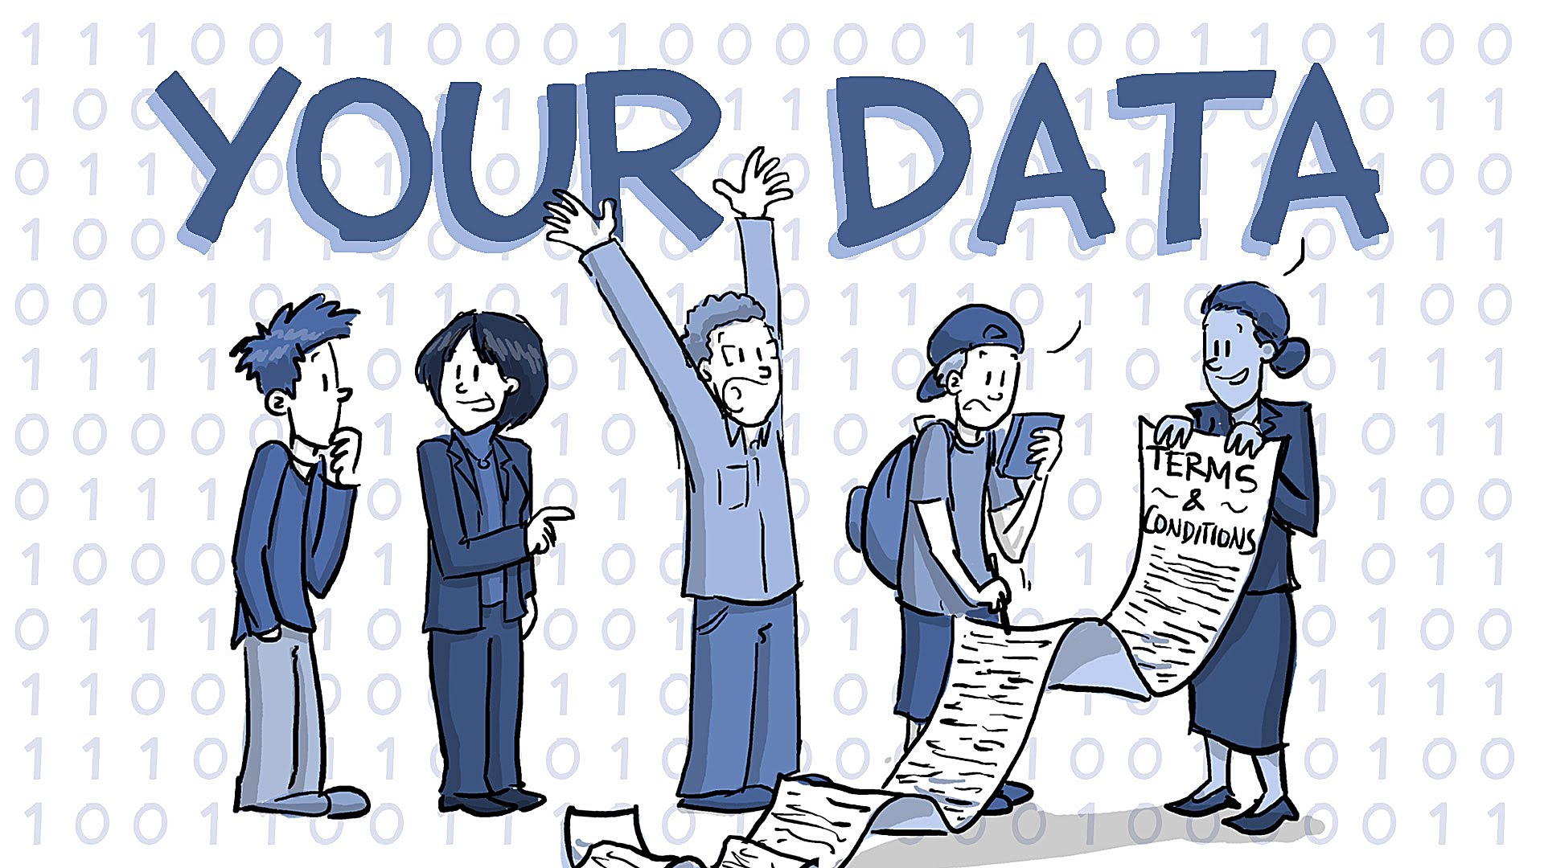
Messages, Images, Videos. Who does your data belong to?

Slide 23
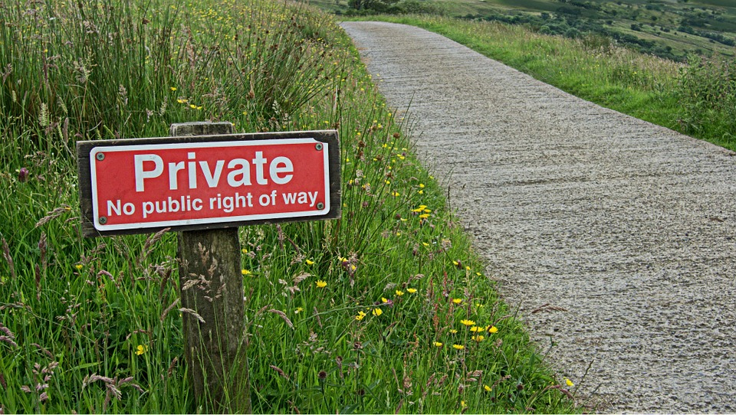
Task – Who owns your data?
In you’re PowerPoint presentation investigate:
On social media sites who owns the data you add to them?
Why are these sites / services free?
What implications (what does this mean) does this have for you?

Slide 24
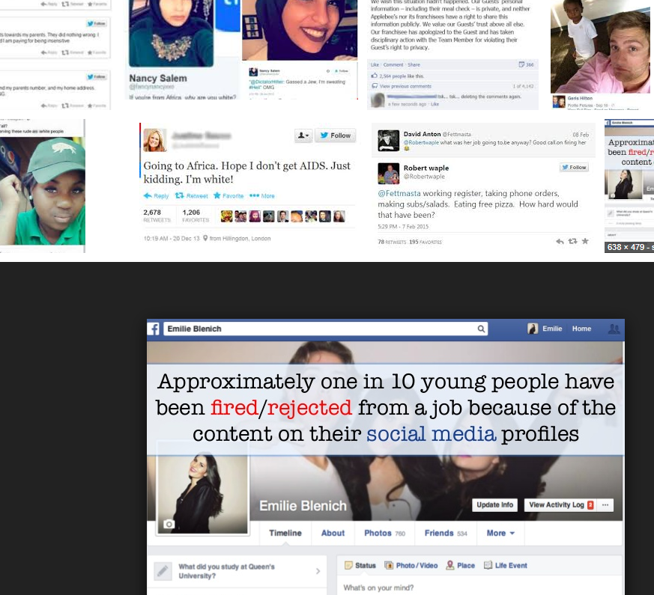
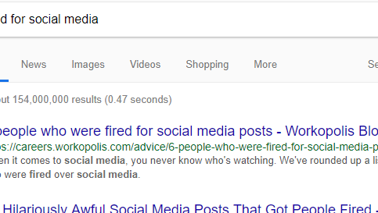
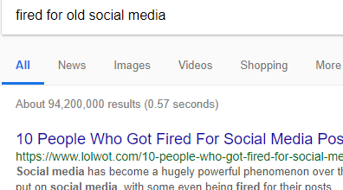

Slide 25
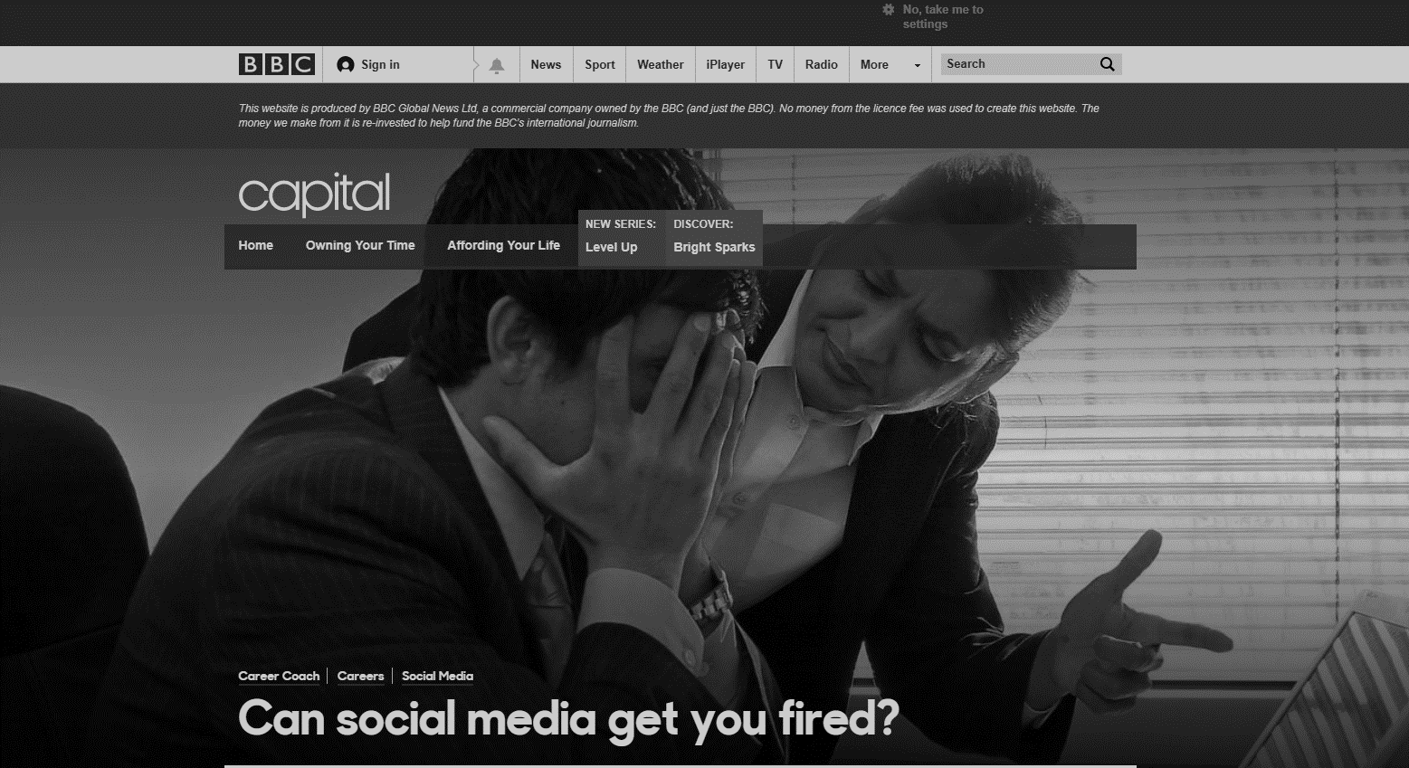
“One in 10 job seekers between the ages of 16 to 34 have been rejected for a job because of something posted on their profiles” BBC 2014 (research firm on device research)

Slide 26
So what if we chuck a stone into the puddle?
Do messages, images and such we send directly to each other matter?

Slide 27
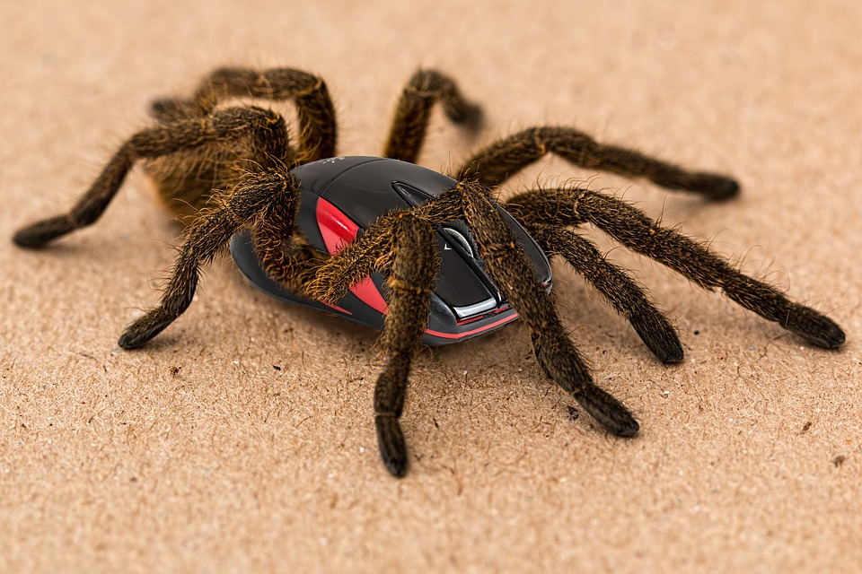
What effects can negative messages / post have?
In your PowerPoint list some of negative effects posts can have.
Think about:
Losing jobs
Friendships
Mistaken posts
Bullying
Long term effects
Can you take it back?

Slide 28
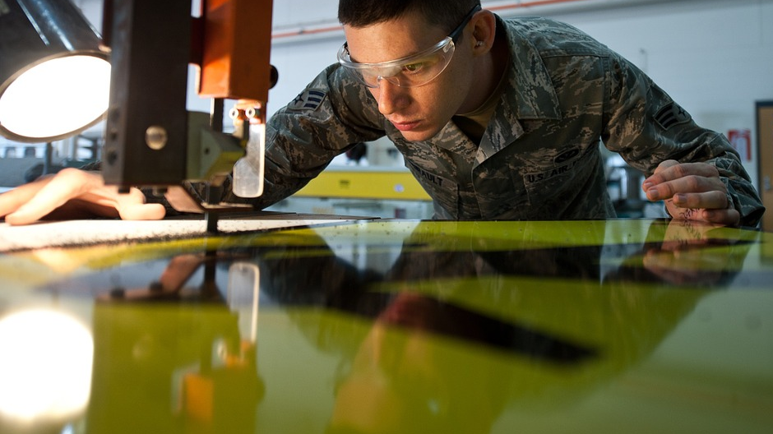
The internet is an amazing tool.
Just use it wisely and safely.

Slide 29
5 p’s for a positive digital foot print
Permissions
Profile
Privacy
Positive
Protect

Slide 30
Lets investigate each of the 5p’s
Permissions
What is meant by permissions?

Slide 31
Profile
What do mean by profile?
How does this have an effect on digital safety?

Slide 32
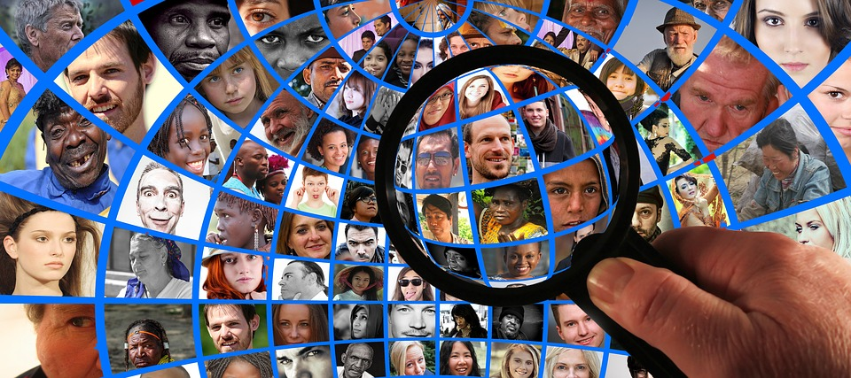
Privacy
What do mean by privacy?
How does this have a effect on E safety?

Slide 33
Positive
What do mean by Positive?
How does this have a effect on E safety?

Slide 34
protect
Protect each other online. If you see something wrong then report it to others.

Slide 35
In your own words describe the 5 positive steps to a healthy digital foot print in your powerpoint.
Permissions
Profile
Privacy
Positive
Protect

