Slide 1
Do Now Task
Turn on your computer
1
Log in.
2
Answer the do now questions below.
3

Slide 2
Answer in time.
7 Minute
8 Minute
Time over.
6 Minute
5 Minute
3 Minute
4 Minute
1 Minute
2 Minute
In total the exam questions here are worth 7 marks.
All these questions are from theory paper 2.
This exam is 105 min long with 90 marks in total.
105/90 = 1.16min per mark or 70 seconds per mark.
So 7 marks = 8 min in total.

Slide 3

Working the Clock
All about the Processor.

Slide 4
Topic Goals
Recap the Basics of compression
Review and Investigate primary memory, cache, busses and the CPU.
Investigate what Hertz measure and how its relevant to a CPU.
Break down language levels.
Investigate what is inside a CPU
Discovering the Fetch, Decode and Execute cycle.
Teach them the fetch decode and execute cycle.
Extension – FDE in detail.

Slide 5
Reviewing our answers.
Reviewing our answers to the exam style questions and recapping past learning.

Slide 6
Lets review the compression Questions
Task – Make a note of this on page 1.
Lossless
Lossy
Original
Compressed
Uncompressed
Original
Compressed
Uncompressed

Slide 7

Working Example of Lossless and Lossy
Page 4 – Let make a note of lossy and lossless compression.
Can lossy compression be used for sound, pictures, programs and text?

Slide 8

Task – Update and Answer
Update your answers to 1.A if required.
Answer the questions posed under the heading of: Lossy vs Lossless compression

Slide 9
1.A,B) Dictionary based compression
Sample Text:
Unfortunately time after time it is the case that programmers fail to put enough effort into commenting their code. Effort put into commenting could make the code easier to maintain when the time comes to do this.
Sample Text highlighted
Unfortunately time after time it is the case that programmers fail to put enough effort into commenting their code. Effort put into commenting could make the code easier to maintain when the time comes to do this.

Slide 10
Dictionary Based – Huffman Compression 2.0
Rather than compressing letters and putting that into a compression table.
We compress words or repeating phrases.
Why does this Methord of compression is more efficient the larger the document?

Slide 11

Task – Updating Notes
Complete the notes under the heading: Dictionary based compression.
On page 5.
Then update your answers for questions 1B & 1C as required.

Slide 12
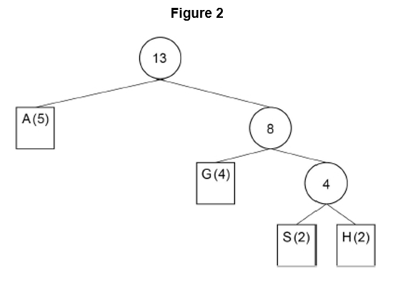
Huffman Question 2A:
Character | Binary code
A | 0
G
S
H

Slide 13
Huffman Question 2A:
Character | Binary code
A | 0
G | 10
S | 110
H | 111

Slide 14
Question 2 B – Space Saved.
How much space has been saved using Huffman compression on:
AAGHHGGSAAASG

Slide 15
Component review
Putting together the ingrediencies for fetch execute cycle.

Slide 16
Task – Research and explain.
Under the heading: Researching Hardware components
Using your knowledge, the class books or the internet in your own words describe what each of the following components are, what they do and how they are measured.
  RAM
  Cache (level 1 , level 2 and level 3)
  Motherboard (what are busses?)
  CPU

Slide 17
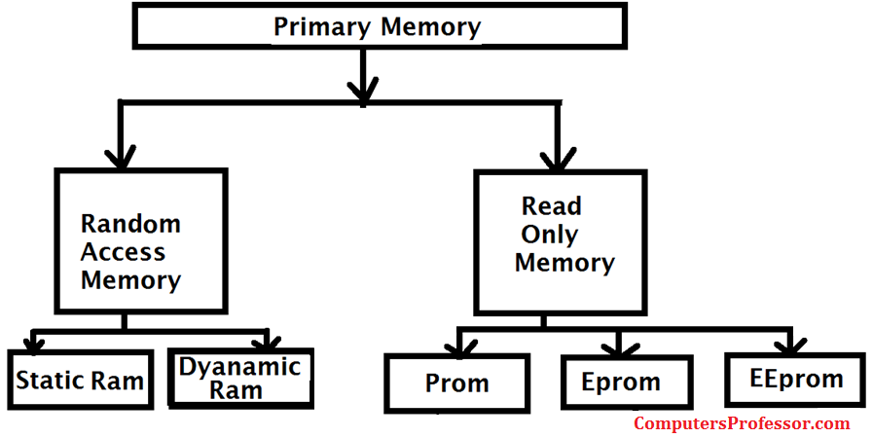
RAM – Primary memory
RAM or random access memory is memory that is part of the primary memory layer (the layer with direct access to the CPU)
This is very fast memory that stores data that is going to be used by the CPU.
It is volatile memory requiring constant power to store data.
This is due to using floating gates to store data.

Slide 18
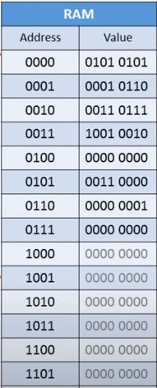
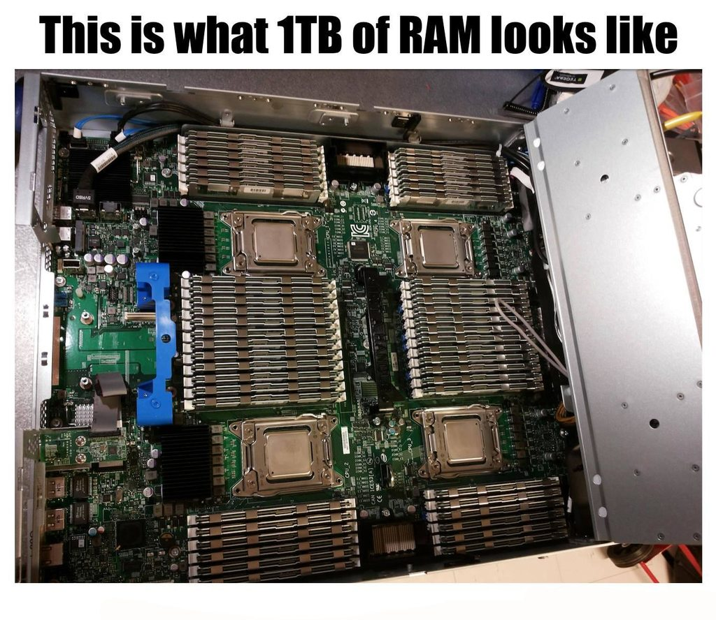
RAM – Continued
RAM is measured primary in two ways:
  Memory size (KB, MB, GB and in the near future possibly TB)
  Hertz (its access speed)
As the name suggests. RAM memory is accessed randomly with each memory location containing a BYTE of data.

Slide 19
CACHE
Cache memory is exceptionally small but fast memory.
The purpose of cache is to act as a buffer to the CPU to increase the memory speed to match that of the CPU clock speed.
In other words, to the CPU RAM is slow. So cache memory to speed up the transfer of information from RAM.
Level 1 Cache is build into the CPU
Level 2 and 3 is built into the Motherboard.

Slide 20
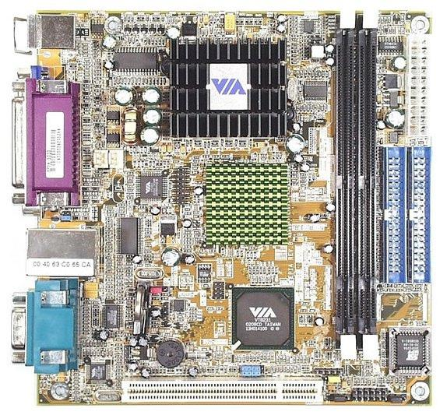
Cache Part 2
Level 3 is the largest cache size, it is also the furthest away from the CPU.
With level 1 as the smallest.
The reason we have smaller and smaller caches is to increase access speed.
Think of it this way. Its easer to search for something in single book than a filling cabinet of books or a room full of books!
This memory is measured much like RAM by its memory size, access speed as well as the location in relation to the CPU.

Slide 21
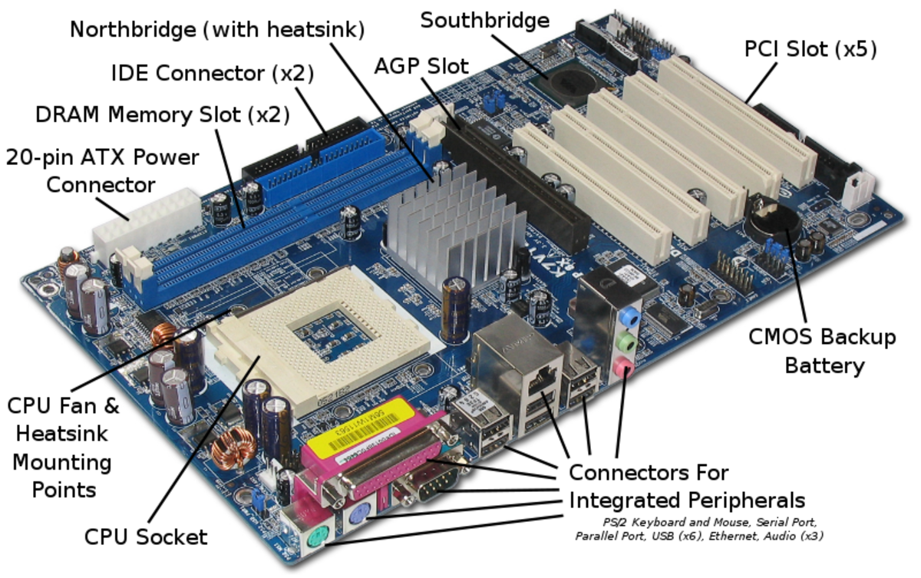
The Motherboard.
If you view the CPU as the brain of the computer the Motherboard would be the body.
The motherboard is the single pathway that links Inputs, Processors and Outputs via Busses.
Busses are the names given to data highways (connections) between different components.
The motherboard is also the home to BIOS which is responsible for all basic operations of all connected hardware.

Slide 22
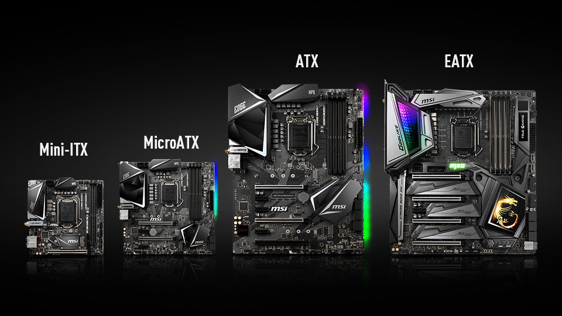
Motherboard Continued
It is generally measured by:
  Physical size.
  CPU slot
  Memory Slot
  Connectivity
  Number / colour of LED …. Yeah some people are that sad.

Slide 23
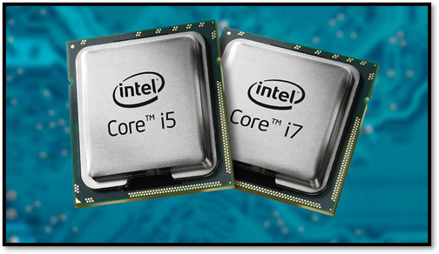
CPU – What is inside.
The Central Processing Unit is exactly what the name suggests. The main processor in the computer.
  There are many other processors such as the GPU, SPU and NPU.
The central processing unit is generally measured by:
  Clock speed
  Number of cores
  Slot size (not generally important)

Slide 24
CPU – What is inside.
The Central Processing Unit is exactly what the name suggests. The main processor in the computer.
  There are many other processors such as the GPU, SPU and NPU.
The central processing unit is generally measured by:
  Clock speed
  Number of cores
  Slot size (not generally important)

Slide 25

What does the CPU do?
Introducing the Fetch Decode Cycle
As you watch this video I would like to you to think about these questions:
What is inside the CPU?
What is the fetch decode cycle?
What happens in every stage?

Slide 26
Defining the Fetch Decode Cycle
Under the heading of: Overview of the Fetch Decode Execute Cycle answer the following.
  What is a clock cycle? Describe what the role of the clock is.
  Describe the steps taken in the cycle?
You can use any resource to help answer these questions.

Slide 27
RISC vs CISC - Instruction registers
From the last video we saw that instructions are broken down and decoded using an instruction register.
This register holds the methods to complete all possible CPU instructions.
Though we use only 10% of these instructions 90% of the time.
What could we do to speed up the processor?

Slide 28

Would it be easier to search for a book in a library or in a single draw?

Slide 29
CISC vs RISC
RISC – Reduced instruction Set Computing
Apple computing choice of processor.
Small register increasing the speed of search's for the 90% of all functions.
However for the 10% of functions it was significantly slower with additional steps.
CISC – Complex Instruction Set Computing
Windows and Intel's choice of processor.
All instruction searches took the same amount of time.

Slide 30

Conclusion of the CPU fight.
In the end all processors have kind of merged with all modern processors becoming a hybrid of both processors types.
However it highlights the importance of CPU architecture which limits software compatibility.

Slide 31
Task – RISC Vs CISC
Complete the questions posed in your OneNote RISC vs CISC section.
What is an instruction library?
What does RISC stand for?
What does CISC stand for?
What was the difference between them?
Do they exist today?
What does CPU architecture mean and what is the name for the two common architectures we use? (NOT RISC AND CISC. You need to look this up)

Slide 32

Exam style questions!
Go and complete the exam style questions.

