Slide 1
Bass Guitar
“The Glue that binds the band together!” LW

Slide 2
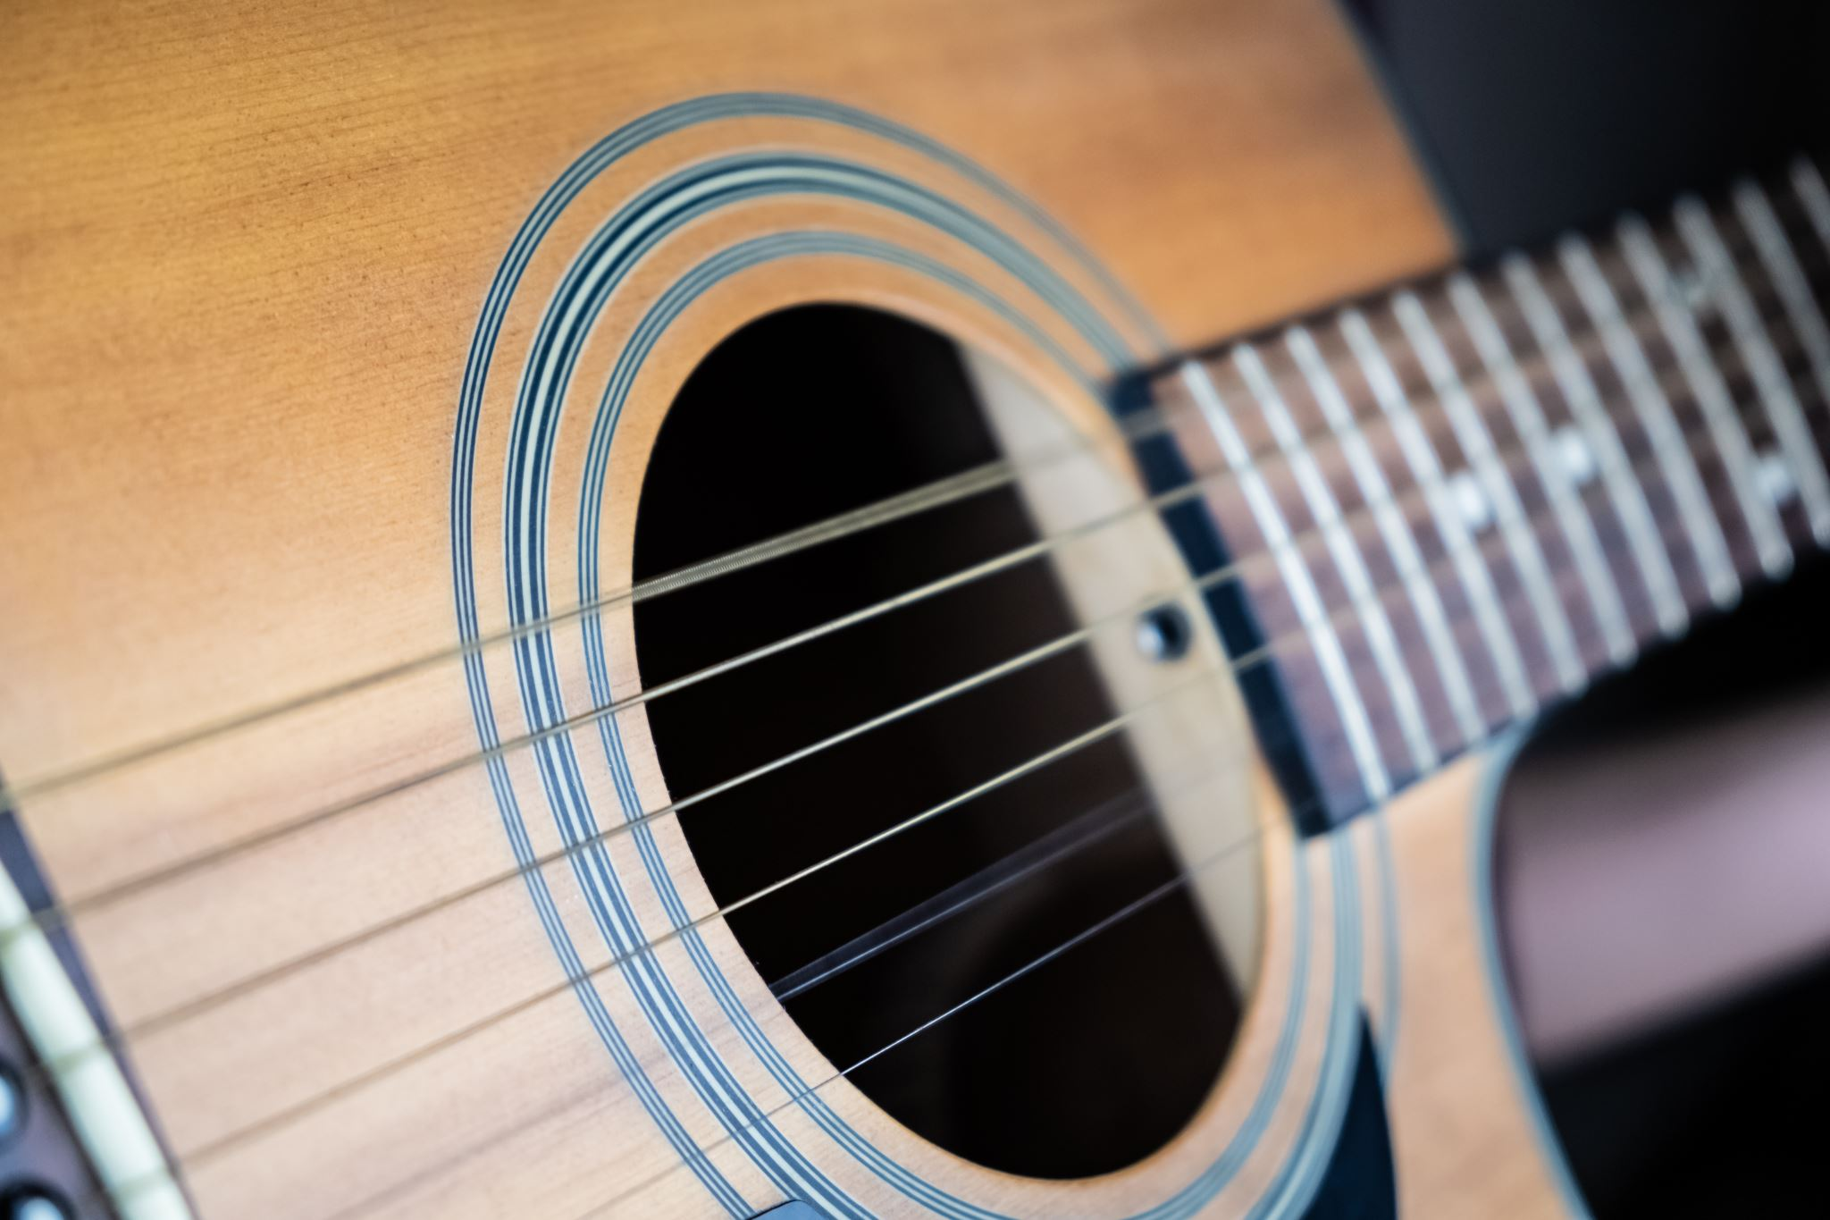
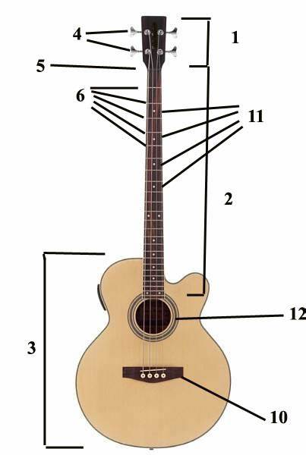
Do Now
What are the parts of the Bass guitar?

Slide 3
Bass Guitar
Numbers tell us the fret. Lines tell us the string.
Bass Guitar

Slide 4
Bass Guitar
Bass Guitar

Slide 5
Bass Guitar
Bass Guitar – Tablature (TAB)

Slide 6
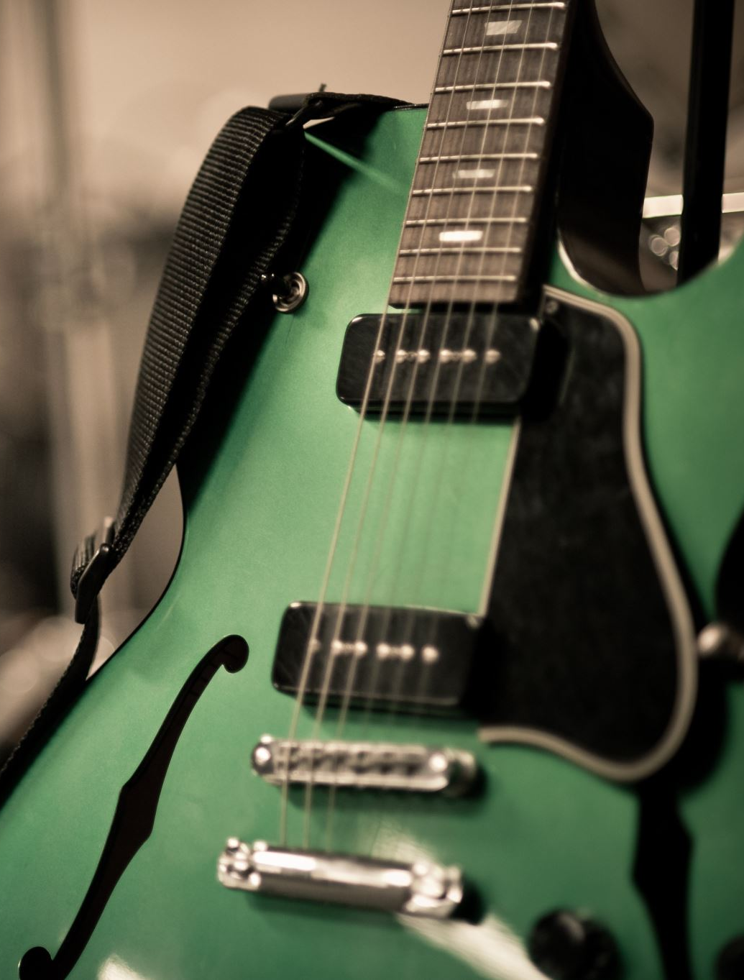
WWW & EBI
What success have you had with the Bass Guitar?
How has the group rehearsed?
Was the rehearsal effective?
Was everyone involved?
Did you all make progress?
Where you able to start together?
Were you able to stay in time?
How could you improve this?
Was it simply focus?
Did you complete all the pieces?
What will you do for next time?

