Slide 1

Musical Forms and Devices
Topic 2 Structures

Slide 2
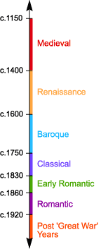
Western Classical Tradition
Western Classical Music Categories
Baroque
Tchaikovsky
JS Bach
Handel
Classical
Romantic
Haydn
Mozart
Debussy
Richard Wagner

Slide 3
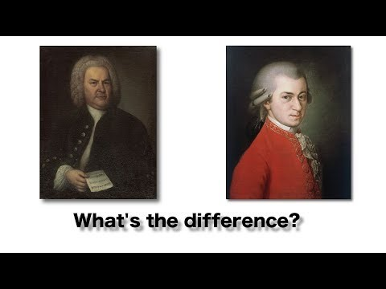
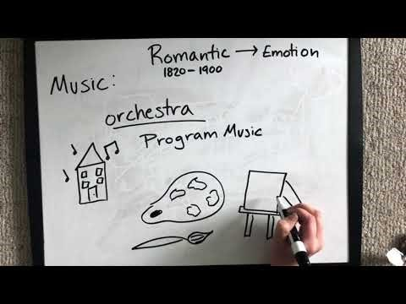
Western Classical Tradition
About the 3 Periods of Classical Music(Baroque, Classical and Romantic) - YouTube

Slide 4
Form and Structure
Music is often organised in a structure using sections of music or passages. In a pop song you would start with an Introduction, then go to the verse then chorus etc...
To write it out you need to learn the section labels. (Add an explanation)
  Intro
  Verse
  Chorus
  Bridge
  Outro
  Coda
  Codetta
  Interlude
  Middle 8
  Instrumental

Slide 5
Song Form Listening: Bryan Adams – Everything I Do
https://www.youtube.com/watch?v=7u-L243mzfI
Listen to and analyse the song above – Write out the order of the sections like so…
I=Intro, C=Chorus, V=Verse, Ins – Instrumental, etc…
I V C V C V C O
Section no. | 1 | 2 | 3 | 4 | 5 | 6 | 7 | 8 | 9 | 10 | 11 | 12
Section descriptor
Hint/reassurance – The first 7 sections are straightforward but the next sections a little trickier – Good Luck. Hint – Don’t Guess a section if you don’t know what it means.

Slide 6
Musical Forms
  Binary Form:
  Ternary Form:
  Minuet and Trio:
  Rondo Form:
  Variation Form:
  Strophic Form:
In more traditional forms we would describe the sections as A B C D etc… Research the above or use the Eduqas Textbook.

Slide 7
Musical Forms and Devices
Topic 2 Structures – Lesson 2

Slide 8
Classification -
Musical Forms or Structures | Binary | Ternary | Minuet and Trio | Rondo | Variation Theme | Strophic
Put the titles of the pieces on the next slide into to correct box. For instance Binary pieces in the Binary boxes. If this is too small then make a fresh table or list… up to you.

Slide 9
Pieces – Listen to all and workout the structure.
Minuets from Music for the fireworks by Handel (Baroque)
Prelude to Carmen, by Bizet.
‘He was Despised’ from The Messiah by Handel
Lacrymosa from Requiem by Mozart. (Classical)
Purple Haze by Jimi Hendrix
Air and Variations (The Harmonious Blacksmith) from Suite No.5 in E Major by Handel
Eine Kleine NachtMusic 3rd Movement by Mozart (Classical)
Movement 3 from Symphony No. 94 the Surprise Symphony by Haydn
Ecossaises by Shubert for Piano. (Romantic)
3rd Movement from the Cello Concerto in B Minor by Dvorak.
Scarborough Fayre by Simon and Garfunkel.
The Goldberg Variations by JS. Bach

Slide 10
Glossary
  Tonic –
  Da Capo –
  FINE –
  Dominant –
  Repetition –
  Contrast –
  Chorale –
  Ballad –
  Melodic Minor –
  Harmonic Minor –
  Interval –

Slide 11
Musical Forms and Devices
Topic 3 – Major and Minor Scales
Flash Key Signatures Music Game (pedaplus.com)

Slide 12
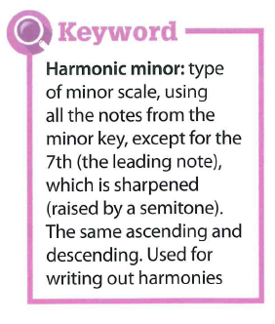
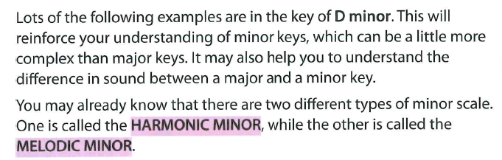
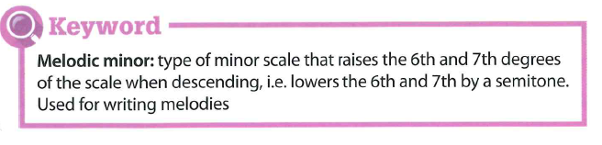
What is a Device?
A device is a feature or technique found in all kinds of music?
The following devices are based around the D major and Minor Scales

Slide 13
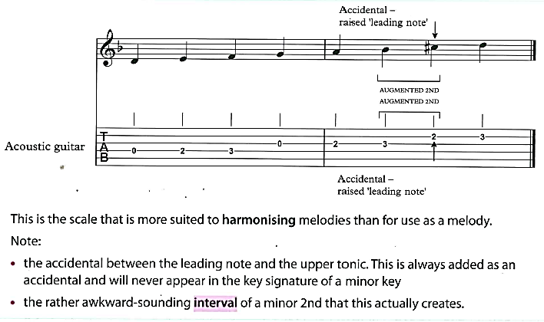
Minor Scales – Harmonic Minor
Songs that use the Harmonic Minor scale - YouTube

Slide 14
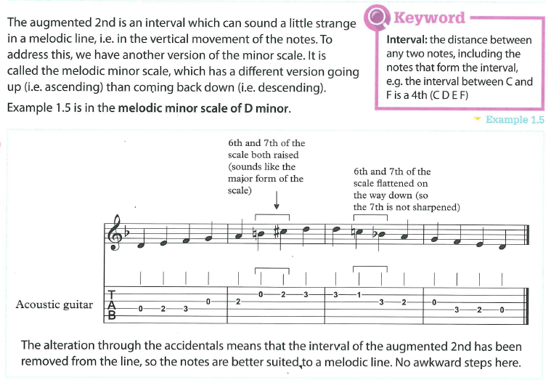
Minor Scales – Melodic Minor
Songs that use the Melodic Minor scale - YouTube

Slide 15
Musical Forms and Devices
Topic 3 – Devices I

Slide 16

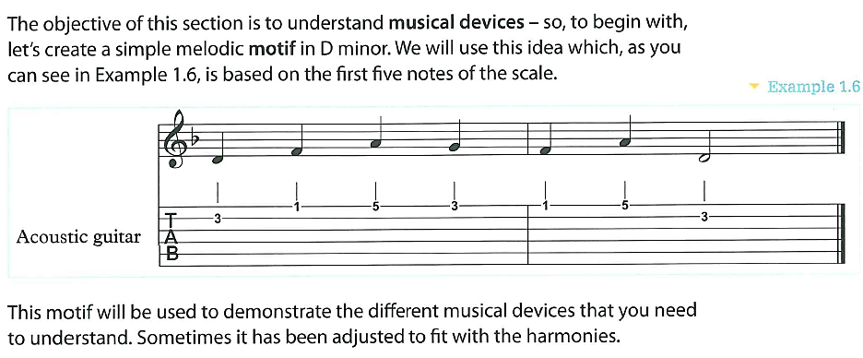
Devices - Motif
Illuminatemusic
PW=Composer

Slide 17
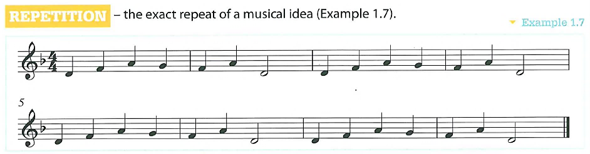
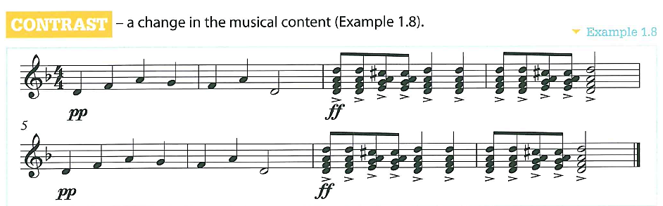
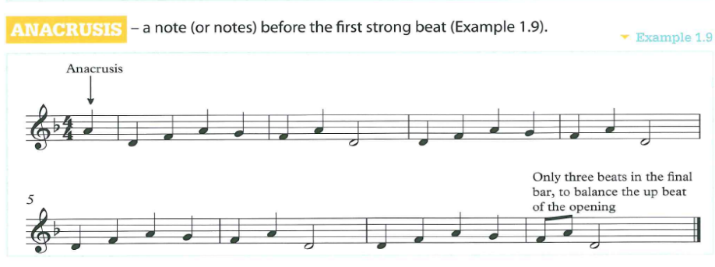
Devices – Repetition, Contrast & Anacrusis

Slide 18
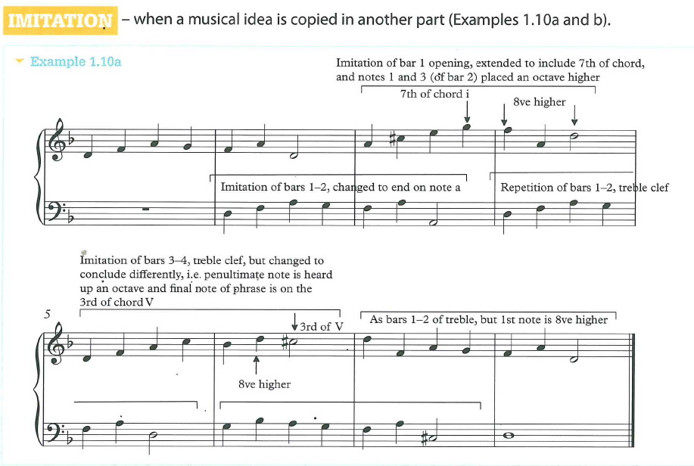
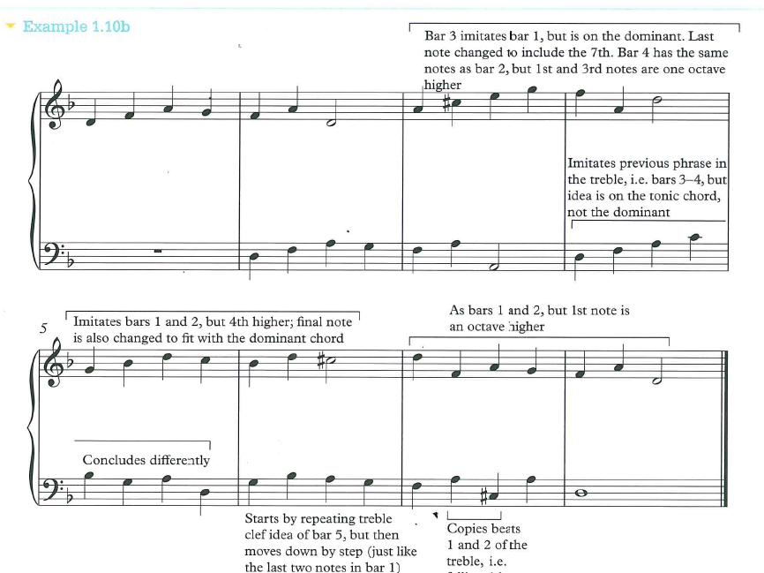
Devices - Imitation

Slide 19
Devices – In the Score
Repetition:
Imitation:
Contrast:
Beethoven - Symphony No. 5 (Proms 2012) - YouTube
Listening Task: Listen to Mozart’s 5th Symphony Introduction (0-45s) and discuss…
What device can you hear at every moment?
Highlight any example of this device. (How do you spot this?)

Slide 20
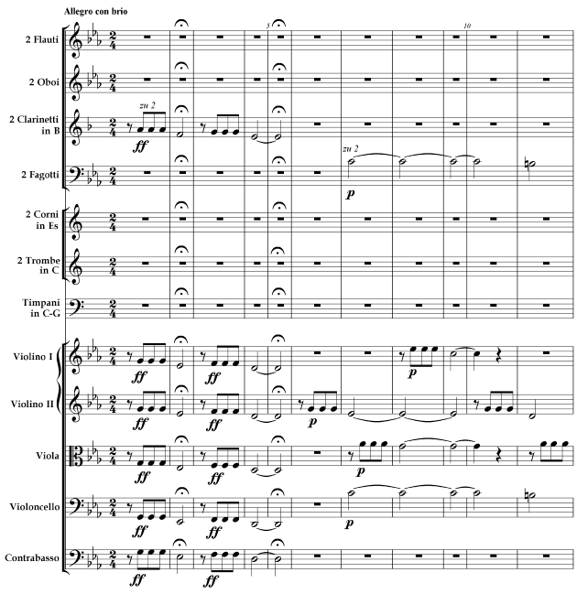
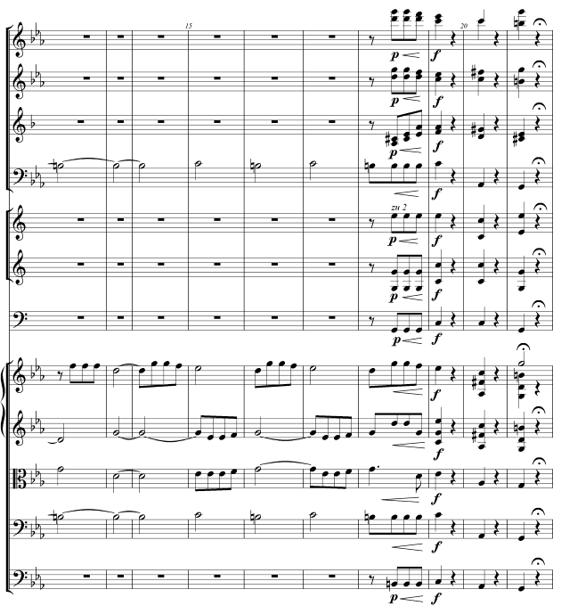
Beethoven’s 5th Symphony

Slide 21
Musical Forms and Devices
Topic 3 – Devices II

Slide 22
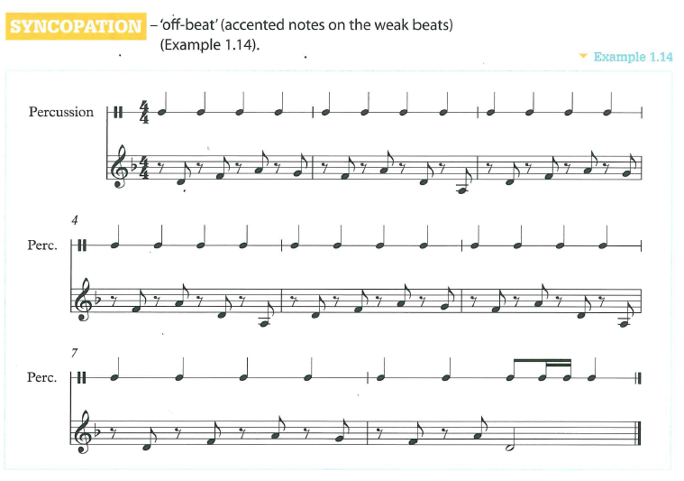
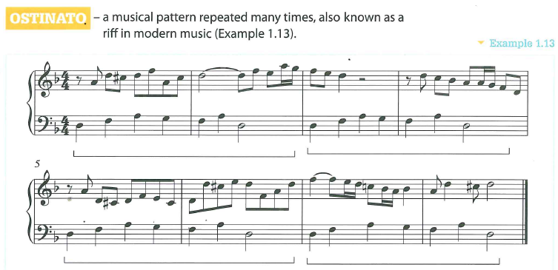
Devices – Syncopation and Ostinato
Dracula theme - Bram Stoker's Dracula theme - YouTube
Jon Cleary - History of New Orleans Piano - YouTube

Slide 23

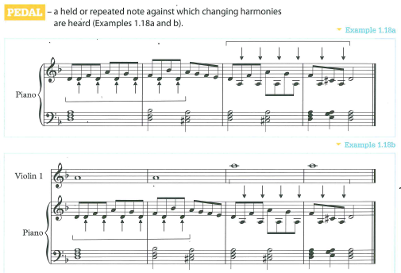
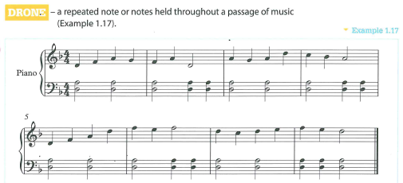
Devices – Drone and Pedal
Illuminatemusic
PW=Composer
Frédéric Chopin's "Raindrop" Prelude, Op 28, No. 15 - YouTube

Slide 24
Musical Forms and Devices
Topic 3 – Devices III

Slide 25
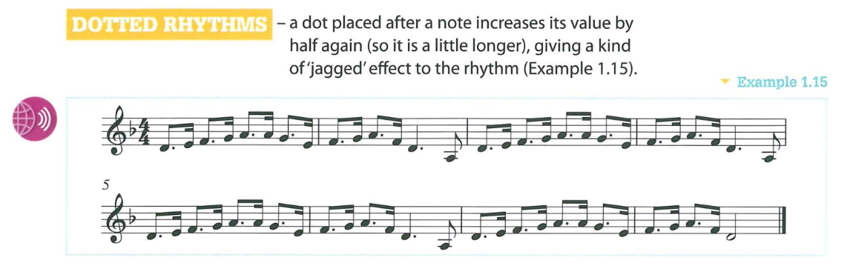
Devices – Dotted Rhythms
Prokofiev: Romeo and Juliet, No 13 Dance of the Knights (Valery Gergiev, LSO) - YouTube
Berlioz - Symphonie Fantastique - March To The Scaffold – YouTube (From 1’30’’)

Slide 26
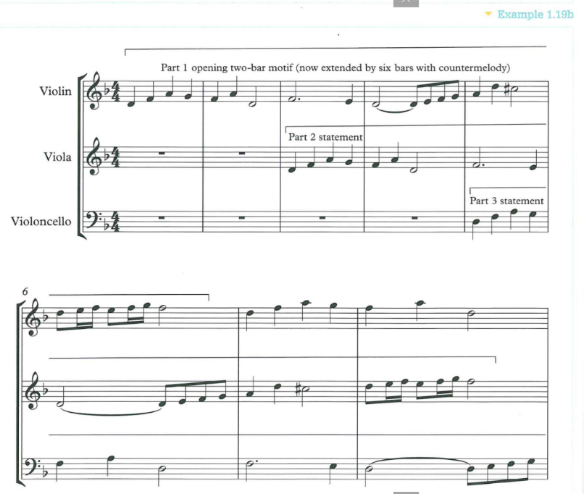
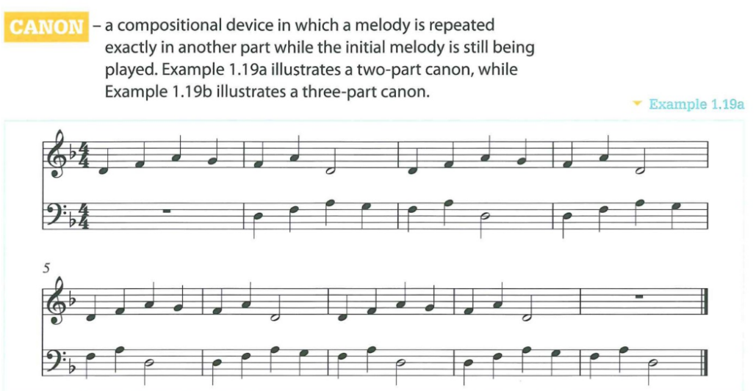
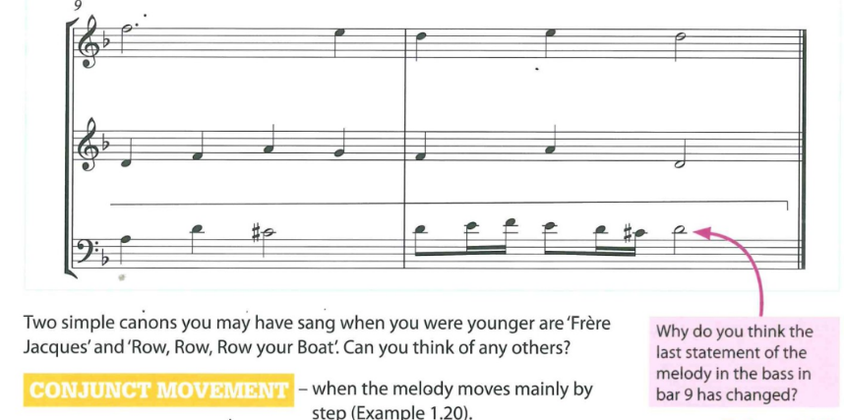
Devices - Canon

Slide 27
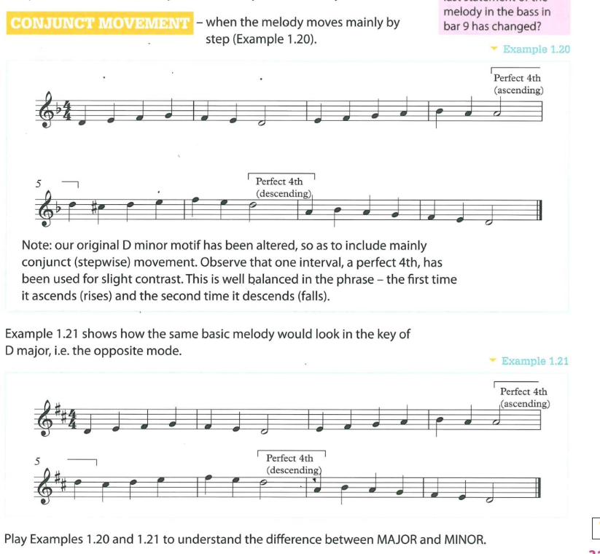
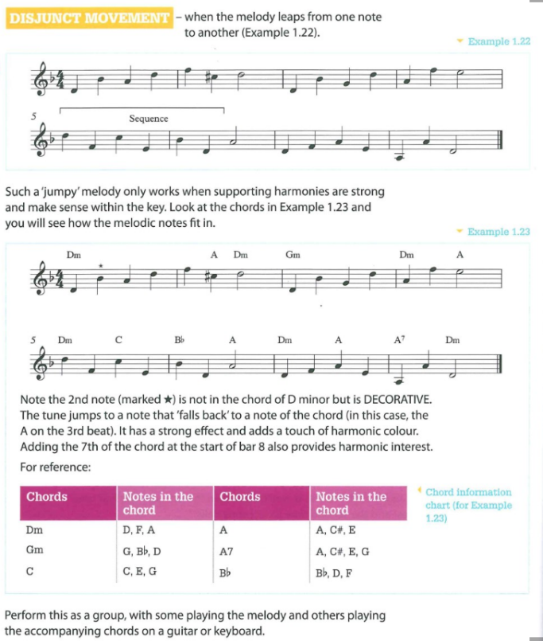
Devices – Conjunct and disjunct Movement

Slide 28
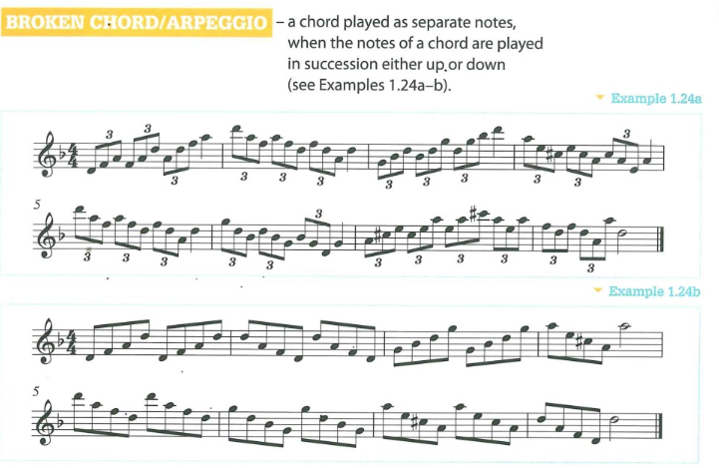
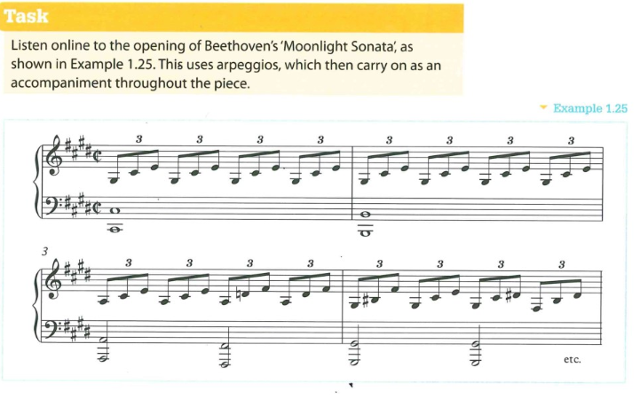
Devices – Broken Chords or Arpeggios

Slide 29
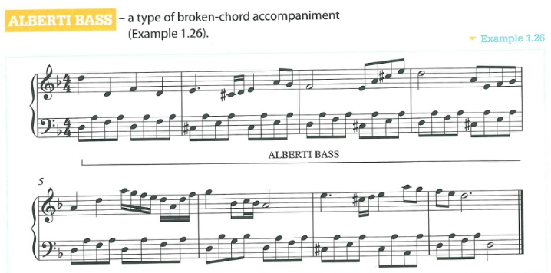
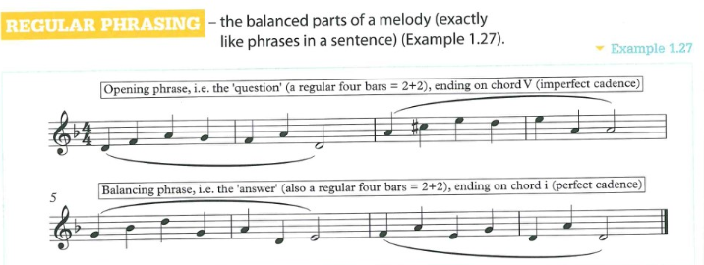
Devices – Alberti Bass and Regular Phrasing
Mozart - The Piano Sonata No 16 in C major - YouTube

Slide 30
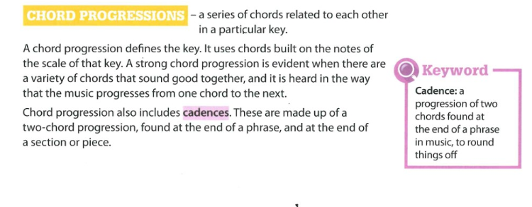
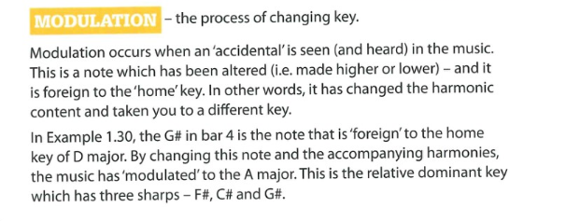
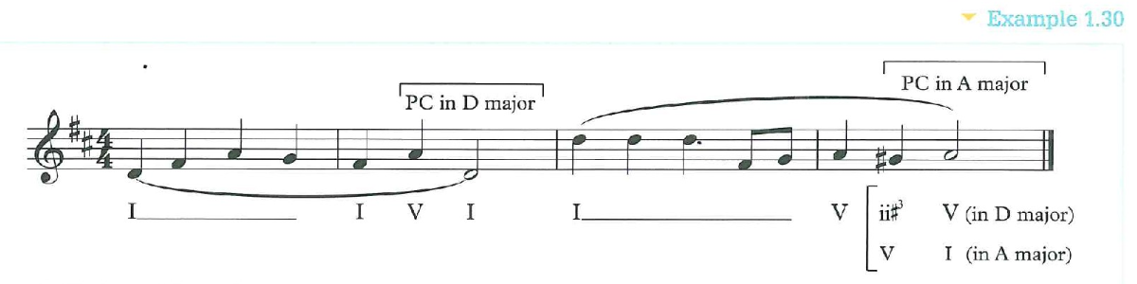
Devices – Chord Progressions

Slide 31
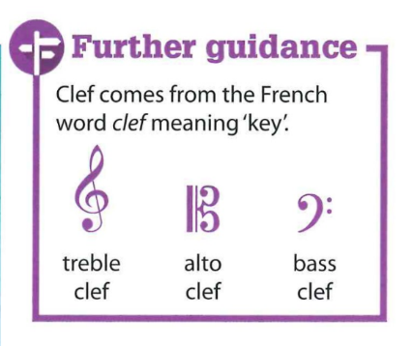
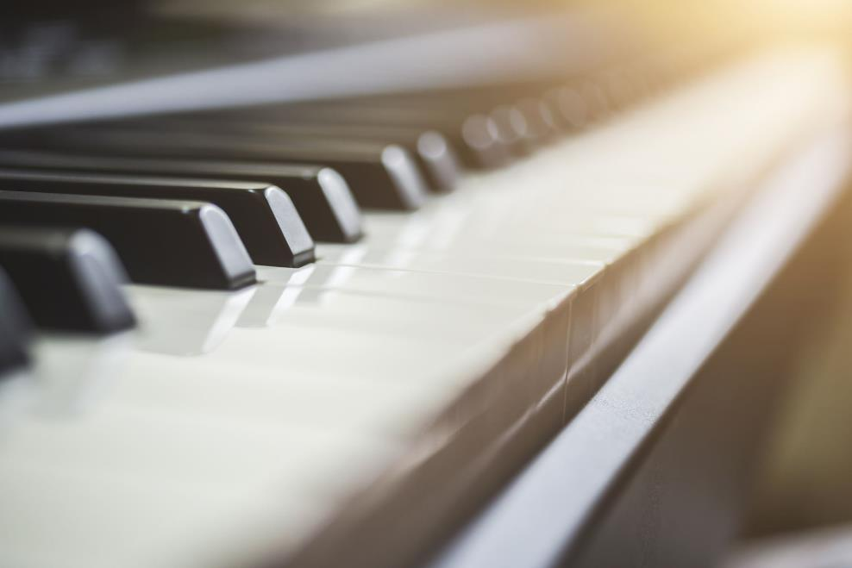
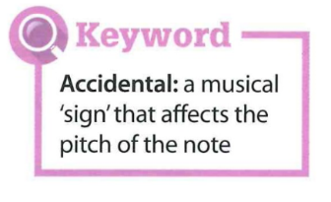
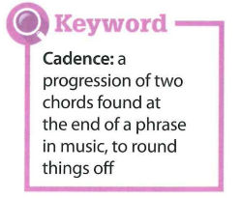
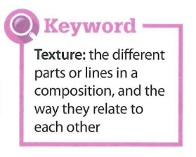
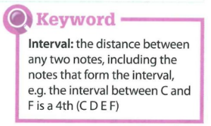
Chord Progressions - Composition Help Sheets for Major and Minor Scales

Slide 32
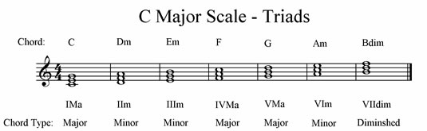
Diatonic Harmony
Use the chords to create your own chord progression. If you have no keyboard use online keyboard.
Use 4 chords
Try 8 chords
Play the chords with different bass notes.
e.g. C Dm/F F G/B G7
4. Compose a melody that goes with it. Add chord tones that travel between the chords.

Slide 33
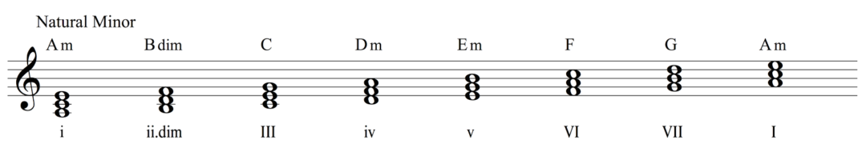
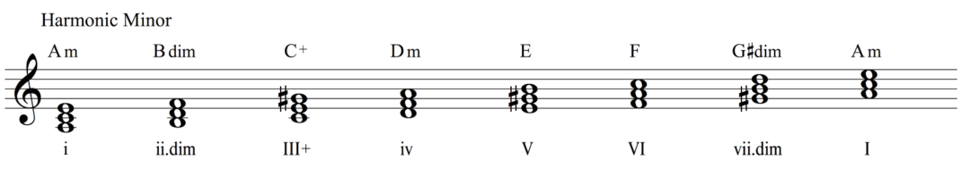
Chromatic Harmony
Chromatic harmonies are when you add chords to a piece from outside the key. This works very well when composing in a minor key.
Task: Choose a Minor key (no pun intended) write a 4 chord trick then add a chord from outside the key. Example: (Natural Minor)
|Am |Em |F |G | Now with a Chromatic Chord |Am |E |F F#dim |G |
https://www.youtube.com/watch?v=-amnre-0I3w

Slide 34
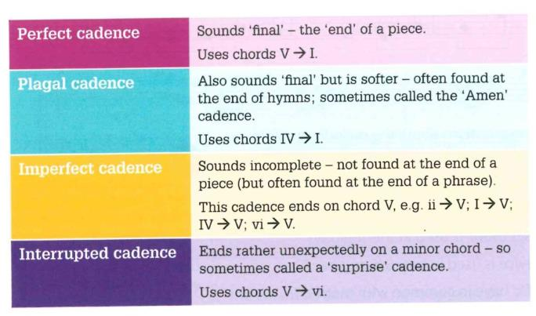
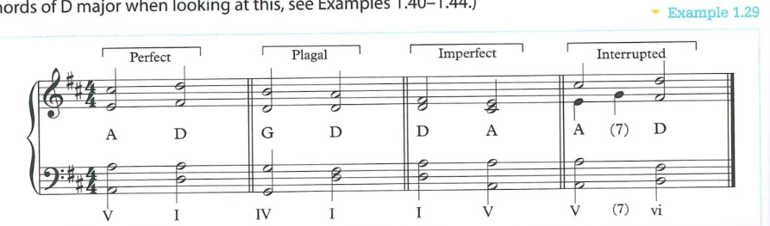
Cadences – Perfect, Plagal, Interrupted & Imperfect

Slide 35
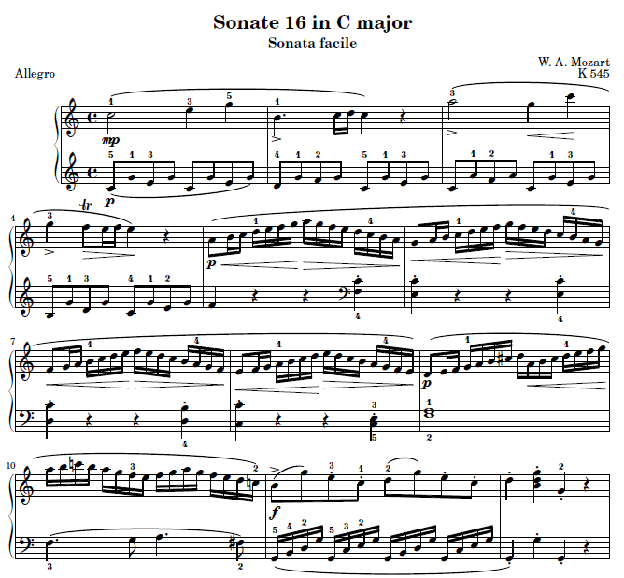
Assessment
Listening and following the Score
What key is the piece in?
How many sharps/flats (#/b) in the key signature?
Who wrote the piece?
What to these signs ask the performer to do?
>
p
f
mp
Name the two prominent devices in the piece
1)
2)
Mozart - The Piano Sonata No 16 in C major - YouTube

Slide 36
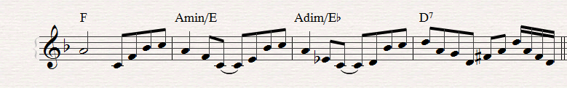
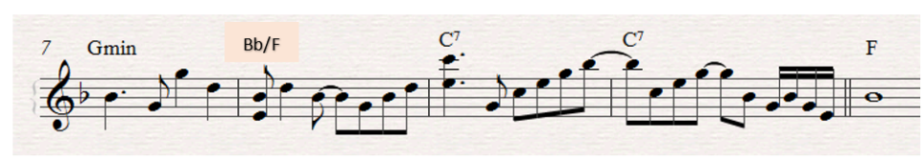
Advanced Devices - David Bowie – Life on Mars
Chord Masterclass
Starter
Complete an F major Scale and add appropriate Chord Qualities
I | ii | iii | IV | V | vi | vi
F
Analyse these chords (Add their Roman Numerals)
https://www.youtube.com/watch?v=pY27JurC1Y0
What is a line Cliché?
What is a Dominant Chord?
What is meant by Directional Chords?
What is Functional Harmony?

