Slide 1
J.S.Bach: BADINERIE from Orchestral Suite No.2
Musical Form and Structure – Set Work 1

Slide 2
J.S.Bach: BADINERIE from Orchestral Suite No.2
J.S. Bach - Suite No. 2 - Badinerie
The Composer
Johann Sebastian Bach was a German composer and musician of the Baroque era.
Date of Birth: 31st March 1685
Death: 28th July 1750. (65)
He is known for compositions such as the Brandenburg Concertos and the Goldberg Variations, Bouree in E, Toccata and Fugue in D minor and for vocal music such as the St Matthew Passion and The Mass in B minor.
He is one of the greatest composers of all time. Writing over 1000 pieces in his lifetime and being responsible for the way modern music has been tempered and adjusted to enable all keys to work together. (Previously all notes in each key were tuned slightly differently.)
Modern Music owes everything to J.S. Bach.
Air - Johann Sebastian Bach
Bach Cello Suite No.1 in G
Bouree In E Minor
Toccata and Fugue in D Minor
2

Slide 3
Overview of Badinerie
Compositional:
Instruments
Tempo
Dynamics
Form and Structure
1738-1739. Orchestral Suite No.2 contains seven movements (sections): Overture, Rondeau, Sarabande, Bourree, Polonaise, Menuet and Badinerie.
Flute, String Orchestra and Harpsichord (Basso Continuo).
Allegro
Mostly forte, including use of terraced dynamics (although very few markings appear on the score, which was typical of the period).
Binary form (AB), with each section repeated once (AABB):
Section A Bars 02 – 16 bars (16 bars)
Section B Bars 16 – 40 bars (24 Bars)
3

Slide 4
Overview of Badinerie
Tonality
Harmony
Melody
Melodic Features:
Rhythm and Metre
Texture
Section A begins in B minor and ends in F# minor whilst section B does the opposite, beginning in F# minor and ending in B minor.
Diatonic throughout. Section A modulates from the tonic to the dominant minor whilst Section B does the opposite.
The movement is based on two short musical ideas (X and Y).
Trills: Bars 8, 10, 15, 27, 30 and 32
Ostinato rhythms, form the basis of the two short musical ideas (X and Y), each contain quavers and semi-quavers.
Homophonic (melody and accompaniment). The flute and the cello are the main musical forces.
Imperfect and Perfect cadences are present throughout.
The flute part has a two-octave pitch range.
Appoggiaturas: Bars 33 and 40
Chords frequently occur in inversion with occasional use of V7 in third inversion.
The time signature or metre is 2/4.
The 1st violin enter on occasion whilst the 2nd violin and viola consolidate the harmony.
The movement includes ornaments and compositional devices typical of the Baroque era:
Sequences: Bars 6 – 10 and bars 28 – 32.
A Neapolitan sixth chord is used in bar 35. Suspensions also occur in bars 8, 10 and 32.
4

Slide 5
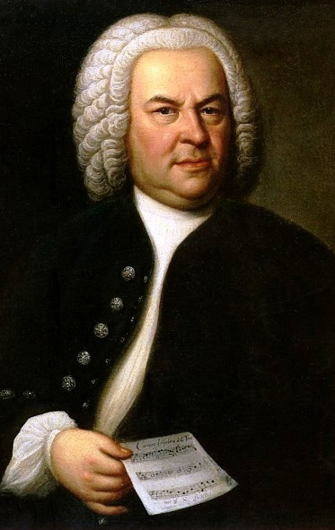
J.S.Bach: BADINERIE Glossary
Task: Find the meanings to the Keywords/Musical Terms in the Badinerie Overview.
Musical Term | Meaning
Instrumentation
Tempo
Dynamics
Form/Structure
Tonality
Harmony
Melody
Metre
Texture
Dominant
5

Slide 6
J.S.Bach: BADINERIE Glossary
Musical Term | Meaning
Allegro
Terraced Dynamics
Binary
Movement
Major
Minor
Motif
Inversion
Neapolitan chord
Musical Term | Meaning
Ornaments
Trills
Appoggiatura
Sequence
Ostinato
Sequence
Homophonic
Polyphonic
Accompaniment
6

Slide 7
Analysis of BADINERIE from Orchestral Suite No.2 by J.S. Bach.
Section | A | B
Harmony | B Minor | F# Minor
Bars | 16 bars (0-16) | 24 bars (16-40)
Motif | X, Y and Y1 (development of Y) | X, X1 (development of X) and Y
7

Slide 8
Main Key - Analysis Tools
Chords | I | ii | III | iv | V | VI | vii
Degree | Tonic | Supertonic | Mediant | Subdominant | Dominant | Submediant | Leading Note
B minor | BDF# - Bm | C#EG – C# dim | DF#A# - D Aug | EGB - Em | F#A#C# - F# | GBD - G | A# C# E – A# dim
F# minor | F# A C# F#m | G# B D G# Dim | A C# E# A aug | B D F# Bm | C# E# G# C# | D F# A D | E# G# B - E# Dim
8

Slide 9
Chord Numbers and Inversions
Intervals
Chords | I | ii | III | iv | V | VI | vii
Degree | Tonic | Supertonic | Mediant | Subdominant | Dominant | Submediant | Leading Note
Seventh Chord Inversion (D7) Try to classify these F chords
9
Notes:
Intervals are used to classify the inversion – The top two notes are used to work out the intervals – The biggest interval goes at the top (Superscript) and the second goes underneath (Subscript)
F – 3/5, 6/4, 6/3, 3/5.
9

Slide 10
Rhythmic awareness
Motif/Idea |  | Rhythm
X |  | Strawberry, Strawberry, Strawberry, Pie
Y
Y (B)
Y1
10

Slide 11
Analysis: Melody The whole movement is based around 2 Motifs.
Bars 0² – 2¹
The movement opens with the first statement of Motif X played by the flute. It is a descending B minor arpeggio with a quaver and semiquaver rhythm.
Bars 2² – 4¹
The flute then plays Motif Y – an ascending idea using arpeggios and conjunct movement with a semi-quaver/quaver idea. Going from B minor arpeggio then to A# dim (The top of F#7) Creating a V – I (perfect Cadence)
11
Notes:
11

Slide 12
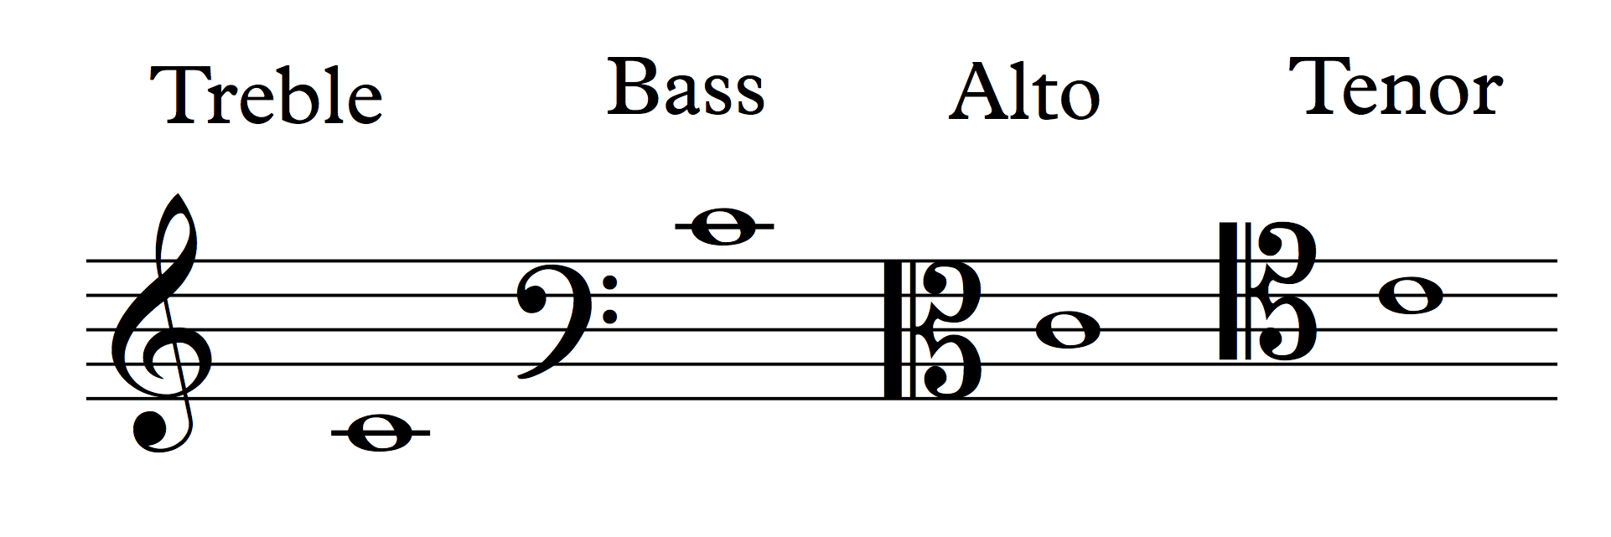
Clef Revision
12

Slide 13
JS. Bach Badinerie Analysis – A Section
Analysis
Motif x
Motif y
Inversions
Cadence
What is question and answer?
Inversions of chord
Simplified Chord Progression
i | ii | V | i
Bm
13
Notes:
Blue: Motif x - The movement opens with the first statement of Motif X played by the flute. It is a descending B minor arpeggio with a quaver and semiquaver rhythm. (Disjunct)
Pink: Motif y - The flute then plays Motif Y – an ascending idea using arpeggios and conjunct movement with a semi-quaver/quaver idea. Going from B minor arpeggio then to A#dim (The top of F#7) Creating a V – I (perfect Cadence)
Inversions – Bm inversions used to movement to the chord.
Cadence - Perfect
13

Slide 14
JS. Bach Badinerie Analysis – A Section
Analysis
What is the original Key?
What does tr mean?
What does the E# indicate? Think Key…
What device has been used by the flute and cello?
Inversions of chord
Simplified Chord Progression
A maj | ii | V | I
F#m | VI | ii | V(next page)
14
Notes:
Device = Imitation
14

Slide 15
JS. Bach Badinerie Analysis – A Section
Y1
Analysis
What is the difference between an imperfect and perfect cadence?
Motif Y1 is an example of what device?
Motif Y is different? How?
Simplified Chord Progression
F#minor | From Bar 8
ii | V | i | iv
Imperfect Cadence
15
Notes:
Motif Y – Has four semiquavers at the end instead of two quavers (Reiterate development to students)
Motif Y1 – Ascending Sequence
15

Slide 16
JS. Bach Badinerie Analysis – B Section
Analysis
What key does the B section start in?
What is the meaning of the two dots at the end of bar 16?
Inversions of chords
Simplified Chord Progression
F#m | From Bar 8
ii | V | i
16
Notes:
Motif resolves to F# Minor (highlight the E#s to students)
Section B is in F# Minor
Motif X is now in F# Minor (B section)
16

Slide 17
JS. Bach Badinerie Analysis – B Section
Analysis
Why is there a blue box over the notes played by the cello in bar 20?
What keys do the piece modulate to from bar 16 to bar 20?
What differences to X1 have compared to X?
Inversions of chords
17
Notes:
X1 = Finishes with Two quavers instead of a crotchet.
Motif X = Now in D Major
(Keys - F# minor, E minor, D major)
17

Slide 18
JS. Bach Badinerie Analysis – B Section
Analysis
What chords feature in the ‘Perfect Cadence’ in Bar 27 to 28?
What is the relationship of D Major to G Major?
The piece is mainly Homophonic although in this part the Flute and violins create a polyphonic texture. What does Homophonic and Polyphonic mean?
18
Notes:
Motif Y is restated then developed in the Flute Parts.
Motif Y1 is a copy of the statement in Bar 12. This is played in D major and includes a perfect Cadence at the end (A7 – D)
D Major is the dominant key from G Major. (One Extra Sharp)
18

Slide 19
JS. Bach Badinerie Analysis – B Section
Analysis
What melodic devices can be seen in this section of the piece? And in what bar and beat? (e.g. X2 starts on bar 32²)
What instrument plays the X Motif in Bar 29?
How is the first X developed? (Look at bar 30)
What is the key of the next Motif X?
What is the device where two melodies create an ascending or descending pattern?
Where is the device found?
19
Notes:
Appoggiatura = 33¹
Trill = 30¹, 32¹
X development is the rhythmic change. (Quaver and two Semi-Quavers)
Key of the next Motif is B minor.
Device – Sequence can be found in the two X Motifs.
19

Slide 20
JS. Bach Badinerie Analysis – B Section
Analysis
What is a Neapolitan Chord?
What is this chord being played? (e.g. D minor?) (The key is B minor)
What device can be found in the Yellow box?
What is different about Motif Y the rhythm in the first part?
Neapolitan Chord
20
Notes:
Neapolitan 6th – Chord built on a flattened 2nd note (supertonic) of the scale. (C major in first inversion – E G C)
Motif Y – As before but with Quaver and Four Demisemiquavers in the first beat.
20

Slide 21
JS. Bach Badinerie Analysis – B Section
Analysis
What two instruments join forces to play Motif X1?
What has Motif X1 borrowed from Motif Y in the previous page? (Bar 34-36)
What else has Bach done to X1 to make it different?
How is the ending achieved in X3?
Inversions of chord
21
Notes:
Motif X1 = Played by the Cello and Flute
Motif X1 = The demisemiquaver idea has been borrowed from Motif Y (on the Previous slide (Bar 34 – 36) but this time put on the ending of the idea.
Motif X1 = Has been inverted so that the pattern ascends rather than descends.
Motif X3 = Ends with a Perfect Cadence and the simplified rhythm helps to highlight this.
21

Slide 22
Where do the keys come from?
D major (Relative Major)
What keys do we find in this piece?
What Bar? | Key | Relationship
Dominant
(1 more Sharp)
F# minor or A major
B Minor
(2 Sharps)
Subdominant
(1 less Sharp)
E minor or
G major
22
Notes:
The origin of the key changes can be found in Bm – Subdominant (IV) and Dominant (V) relationships give us the keys in the triangle above.
22

Slide 23
Glossary II
An appoggiatura is an added note, one step higher or lower than the main note, which shares the value of the main note by some of its value, usually by half. It is written as a grace note (a small note) without a line drawn through it.
Badinerie is a name given in the18th century to a type of quick, light movement in a suite.
The Baroque era is a period of Western Classical music from 1600 to 1750. This period followed the Renaissance era and was followed by the Classical era.
Basso continuo, notated as figured bass, is a system of partially improvised accompaniment played above a bassline, usually by a keyboard instrument. The use of basso continuo was customary during the17th and 18th centuries when only the bass line was written out and the keyboard player was informed which chords to play by reading figures that were placed below the notes. A low melody instrument, such as the cello or the bassoon, usually reinforced the bass line.
A chord’s inversion describes the relationship of its lowest note to the other notes in the chord. A C major triad contains the notes C,E and G. Its inversion is determined by which of these notes is the lowest note in the chord.
A Neapolitan chord is a major chord built on the flattened supertonic (second note) of the key. It most commonly occurs in first inversion and is often referred to as a Neapolitan Sixth chord.
23

Slide 24
Glossary II
A sequence is the repetition of a motif at a higher or lower pitch in the same voice or instrument.
A suite is a collection of short musical pieces, usually dances, which can be played one after another. (e.g – Gavotte, Sarabande, Gigue…)
A suspension is a way of creating temporary dissonance by sustaining a note whilst changing the harmony beneath it, normally on a strong beat.
Terraced dynamics area feature of Baroque music in which volume levels shift suddenly from quiet to loud and back again without the use of crescendos and diminuendos.
A transverse flute is an instrument which is held horizontally to the side when played rather than vertically to the front like clarinet. The modern flute is a transverse flute.
A trill is a rapid alternation between an indicated note and the one above it. Trills may be either diatonic or chromatic. It is indicated by the symbol “tr”.
24

