Slide 1
GCSE Music Theory
Name

Slide 2
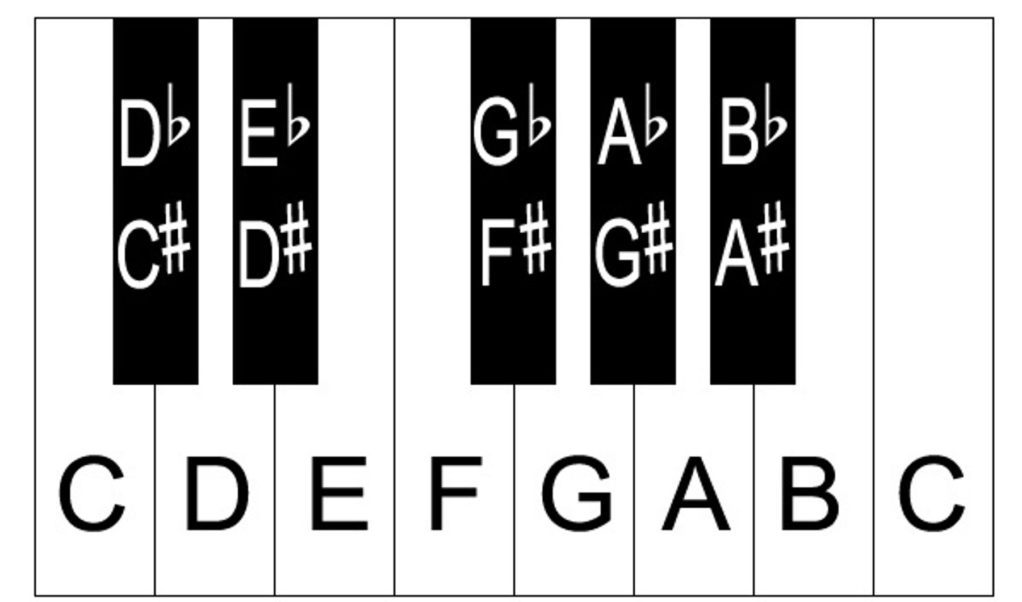
The Piano - Starter
DO NOW TASK
Move to the keyboards and without switching them on find a C, F and a G.
Be prepared to play along – Get ready!

Slide 3
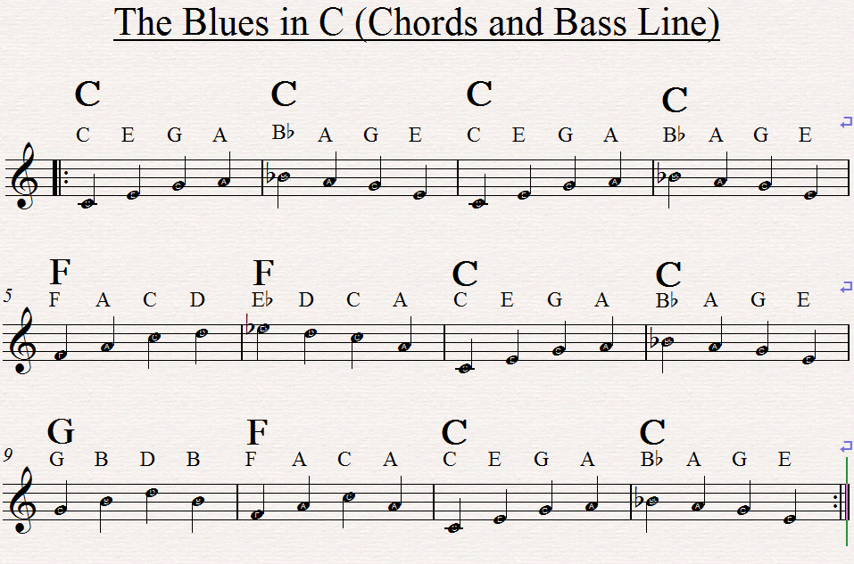
12 Bar Blues

Slide 4
The Musical Stave

Slide 5
Both the Musical stave and the Piano are connected.
Piano: Go Left/Right to raise the pitch.
Stave: Go Up/Down to raise the pitch.
Key terms:
Ascending –
Descending -

Slide 6
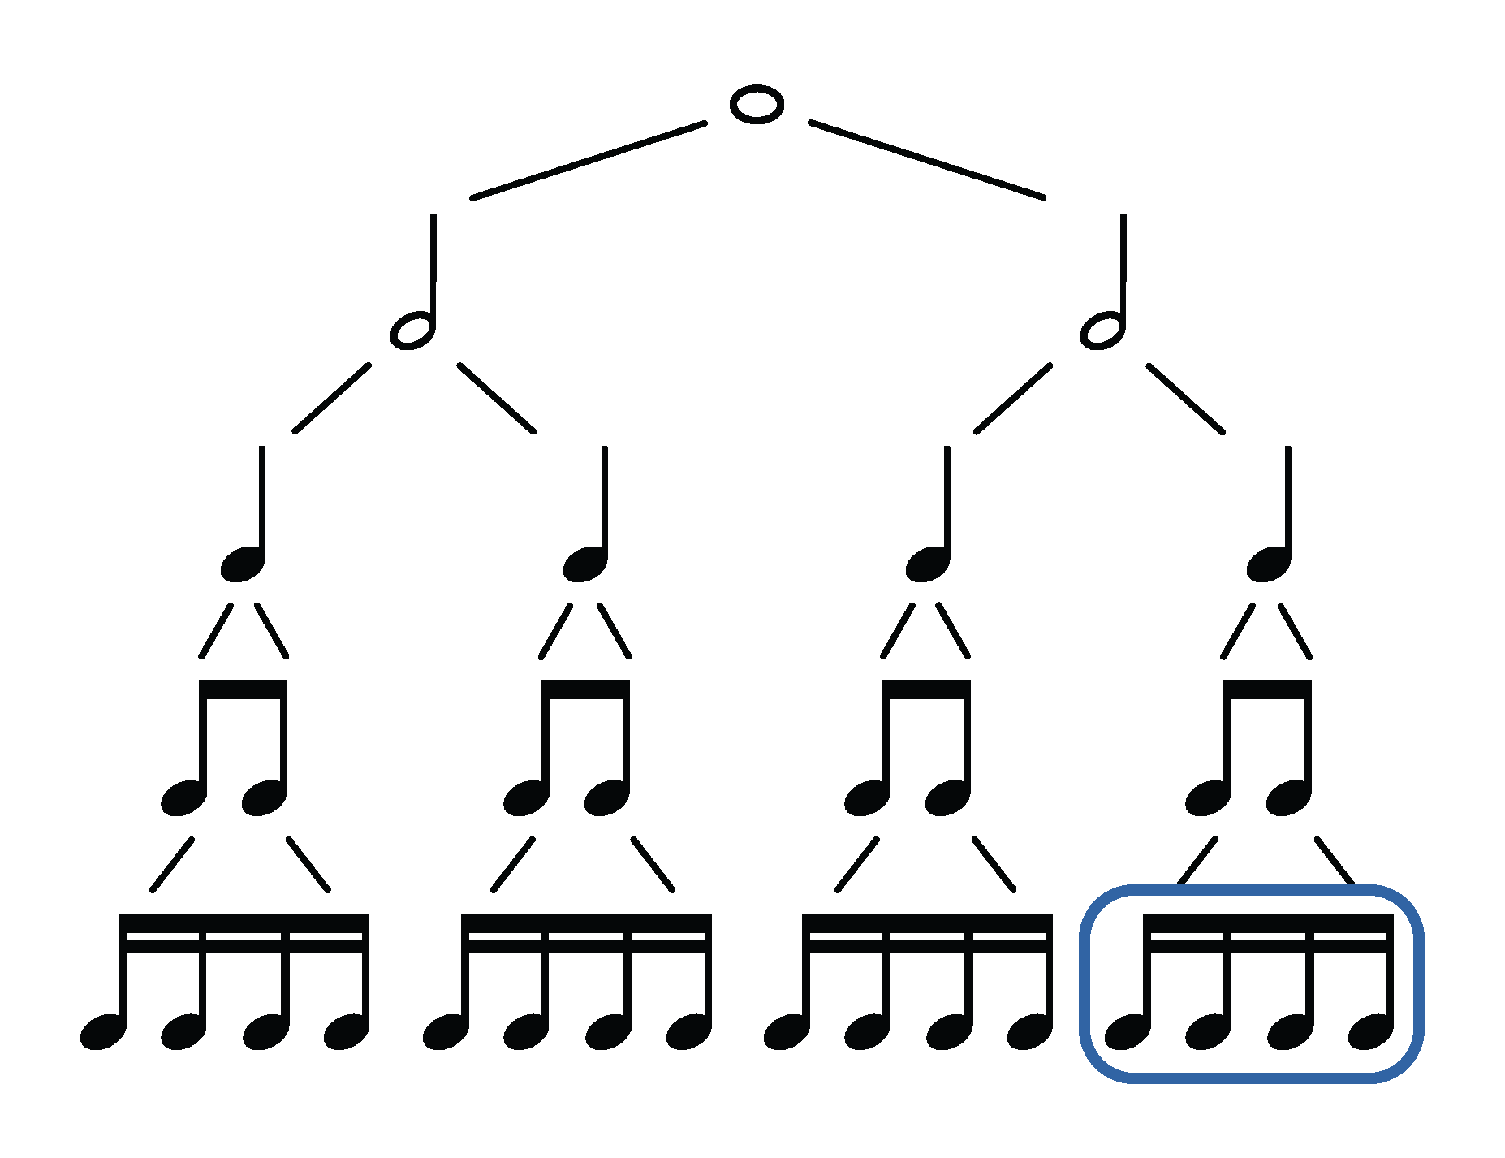
Duration 1) Label the notes 2) Add the duration (4,2,1, ½ , ¼)

Slide 7
Harmonising a C Major Scale
a) Play the C Major Scale on your instrument.
b) Label the notes

Slide 8
Harmonising a C Major Scale
Await instruction
Stack the notes (Triad)
Add Roman Numerals
Add chord names

Slide 9
Harmonising a C Major Scale
Await instruction
Stack the notes (Triad)
Add Roman Numerals
Add chord names

Slide 10
Harmonising a C Major Scale
Play the chords on your instrument
EXT: Play the 7 chords below

Slide 11
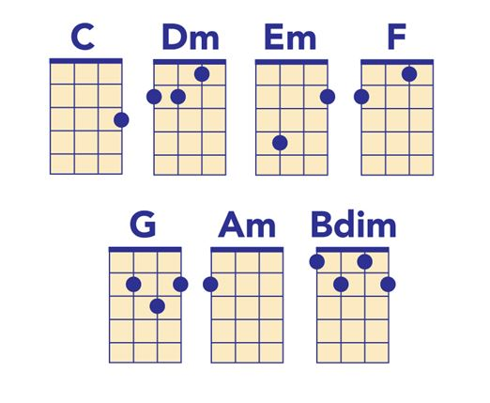
Harmonising a C Major Scale
Play the C Major Scale on your instrument.
Learn the chords

Slide 12
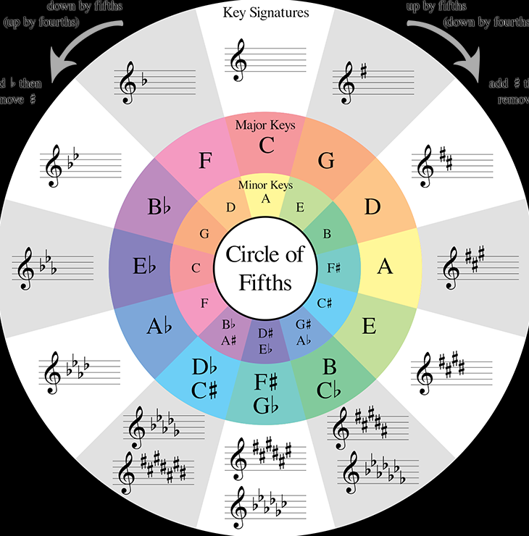
Down by 5ths
(Up by 4ths)
Up by 5ths
(Down by 4ths)
Create a diagram of your instrument: Drummers use the Piano.
Scale practice: Play through the scales
TTsTTTs
T=Tone
S=Semitone

Slide 14
What is Gospel Music? Do we hear it in modern songs? If we were to make our own music, what could we borrow from this style?
Listening Starter

